Slide 1
Using EJSCREEN for MARC Grants
Technical Assistance for Brownfields Program
EPA Region 1
Marisa Chrysochoou, Program Director
Tab.program.uconn.edu

Slide 2
Sections to use EJSCREEN
2a. Community Need – 25 points
ii. Threats to Sensitive Populations – 20
1. Health or Welfare of Sensitive Populations – 5
2. Greater Than Normal Incidence of Disease and Adverse Health Conditions – 5
3. Promoting Environmental Justice - 10
1b. Revitalization of Target Area
ii. Outcomes and Benefits of Reuse Strategy
Determine whether your Target Area falls under the Disadvantaged Community Definition

Slide 3
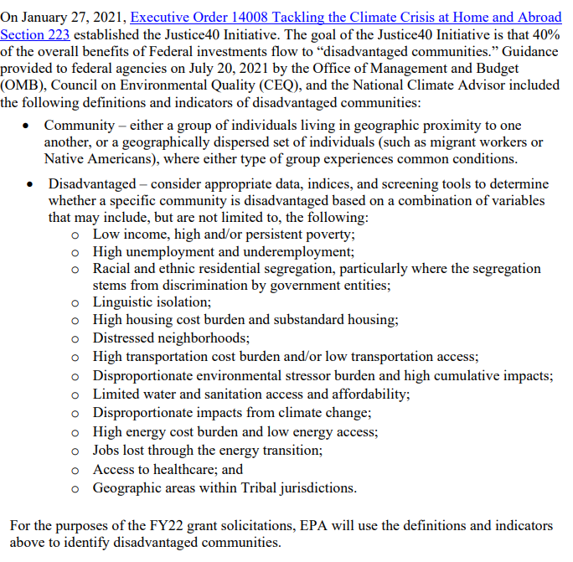
1.b.ii Disadvantaged community
Definition under Justice40 Initiative

Slide 4
2.a.ii Threats to Sensitive Populations
Health or Welfare of Sensitive Populations
Identify children, pregnant women, minority or low-income communities, or other sensitive populations in the target area(s).
Promoting Environmental Justice
Combination of demographic and environmental indicators
EJ Index
Other sensitive populations: elderly
Adverse Health Conditions
EJSCREEN does not have actual health data but several related environmental indicators you can use to supplement health data

Slide 5
Define your Target Area
Site-specific grants: neighborhood (0.25-0.5 mile radius), block group, tract for smaller towns
Community-Wide grants: one or more census tracts, town

Slide 6
Examples from successful grants
Community Wide Assessment Grant, Middletown, CT (population 40,000)
Cleanup Grant, Former Allied Leather Site, 56 Commercial Street, Boscawen, NH (population 4,000)

Slide 7
Middletown, CT
Priority Sites
Census Tracts 5416, 5417
Notes:
This is the entire City of Middletown, encompassing 11 census tracts. The first step is to map the priority sites and see where they are located so you can pinpoint the census tracts and block groups of interest.
In this case Middletown chose to focus the grant on their Riverfront Area, so all four sites are close to each other and they are located within two census tracts. So let’s see how we can get data at the town level and the census tract level.
(Navigate to EJSCREEN)

Slide 8
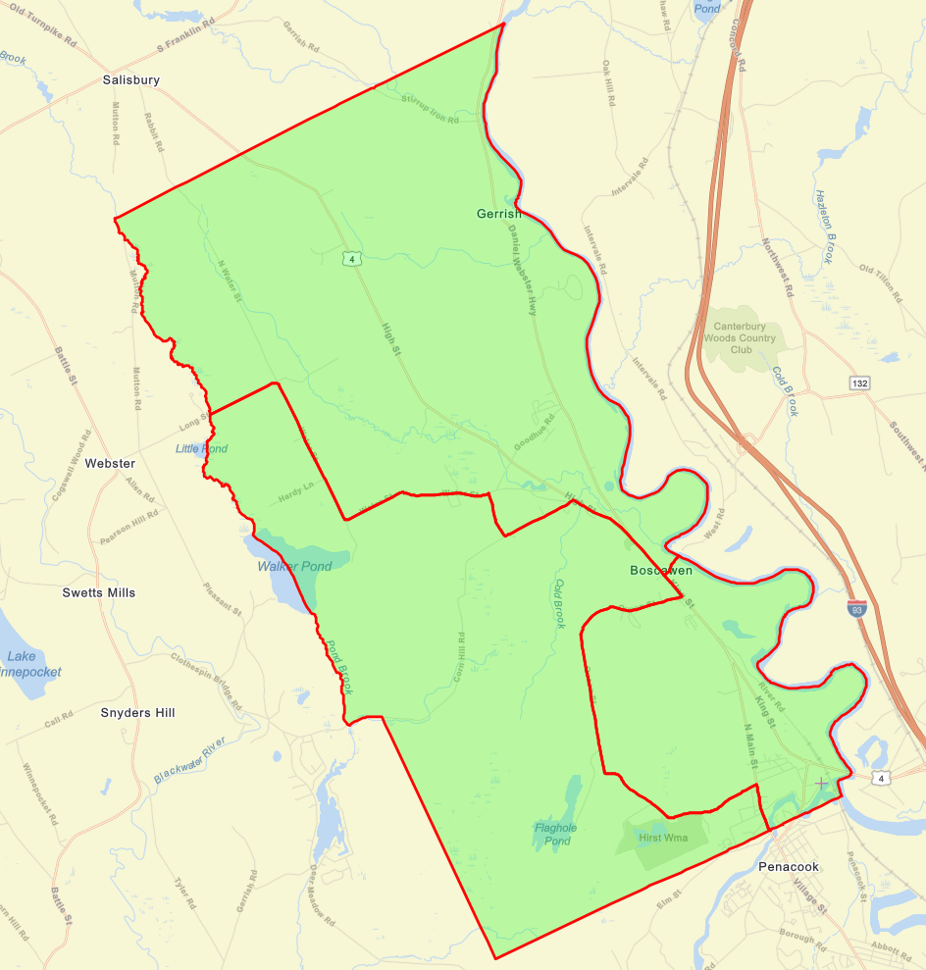
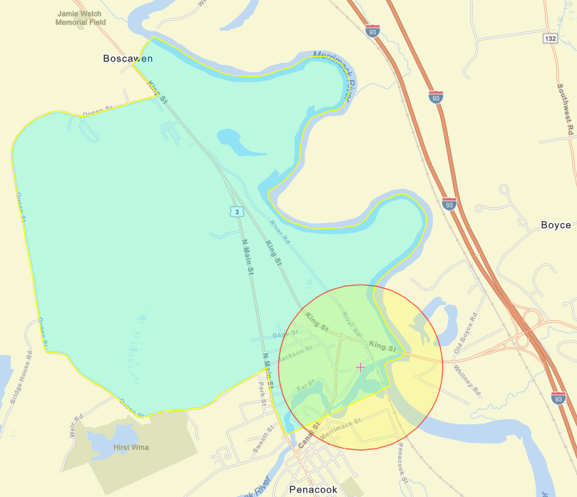
Boscawen, NH
The Town here is a single Census Tract with three block groups
Site
Site-specific report – 0.5 mile radius

Slide 9
Final Demographics Table – Middletown CT
 | Target Area | City | State | EPA Region | USA
People of Color Population | 41% | 32% | 32% | 24% | 39%
Low Income Population | 56% | 23% | 23% | 24% | 33%
Linguistically Isolated Population | 6% | 4% | 5% | 5% | 4%
Population with Less Than High School Education | 13% | 8% | 10% | 9% | 13%
Population under Age 5 | 6% | 6% | 5% | 5% | 6%
Population over Age 64 | 17% | 14% | 16% | 17% | 15%
These are your sensitive populations for section 2a

Slide 10
Final Demographics Table – Boscawen, Nh
 | 0.5 mile radius | Block Group | Census Tract/ Town | State | EPA Region | USA
People of Color Population | 4% | 3% | 3% | 10% | 24% | 39%
Low Income Population | 32% | 36% | 24% | 20% | 24% | 33%
Linguistically Isolated Population | 0% | 0% | 0% | 1% | 5% | 4%
Population with Less Than High School Education | 10% | 10% | 11% | 7% | 9% | 13%
Population under Age 5 | 8% | 9% | 5% | 5% | 5% | 6%
Population over Age 64 | 16% | 18% | 22% | 17% | 17% | 15%
These are your sensitive populations for section 2a

Slide 11
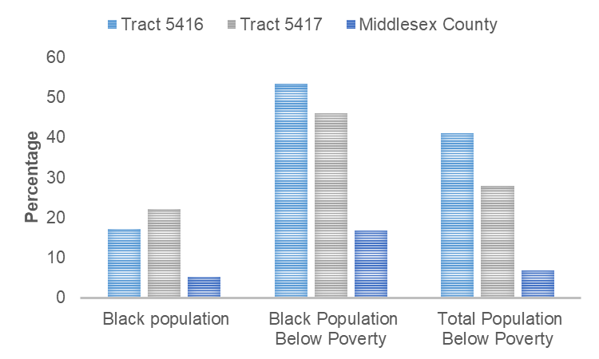
Example– Middletown poverty levels, ACS 2014-2018
 | Percent Black population | Percent Black Population Below Poverty | Percent Total Population Below Poverty
Tract 5416 | 18% | 53.3 | 42.02
Tract 5417 | 22% | 46.2 | 26.13
County | 5% | 16.7 | 7.25

Slide 12
Adverse Health Conditions
These indicators cannot replace actual health data
BUT they can supplement them (cancer, asthma, lead blood levels)
MIDDLETOWN | Target Area | City | State | EPA Region | USA
NATA Air Toxics Cancer Risk (risk per MM) | 26 | 26 | 25 | 25 | 32
NATA Respiratory Hazard Index | 0.31 | 0.31 | 0.31 | 0.31 | 0.44
Lead Paint Indicator (% pre-1960s housing) | 0.68 | 0.37 | 0.44 | 0.44 | 0.28

Slide 13
Promoting Environmental Justice
Demographics (Sensitive Populations)
Environmental (Sources of pollution)
EJ Indices

Slide 14
EJ Indices and how to interpret them
Risk of excess sensitive populations exposed to environmental hazard
Environmental hazard
Excess proportion of sensitive populations
Total excess of sensitive population
Average indicator of key sensitive populations
If you have a sensitive population that is NOT captured in the demographic index (kids or elderly) then you have to discuss environmental indicators separately

Slide 15
Additional resources
EPA EJSCREEN demonstration for Brownfields Grant Applications
EPA EJSCREEN videos

