Slide 1
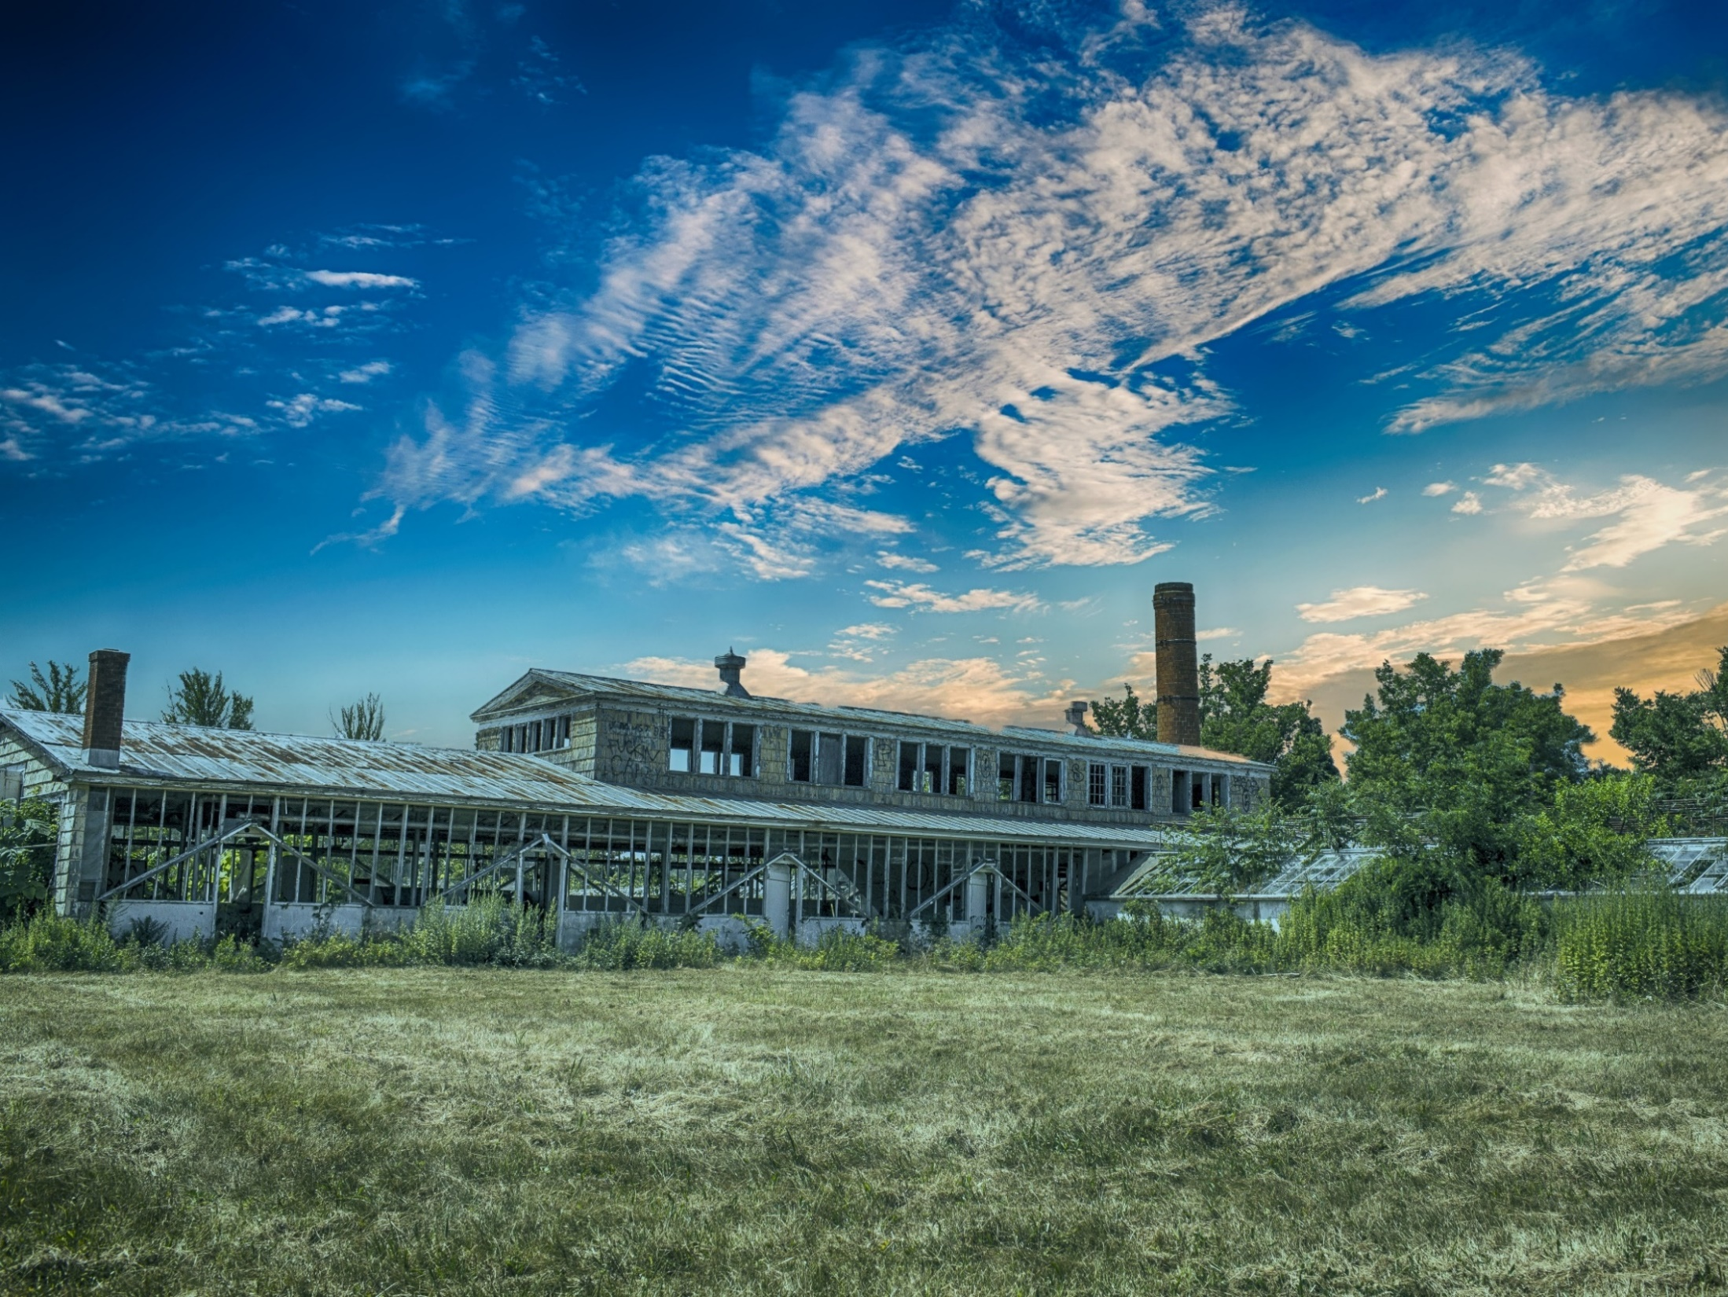
Leveraging EJ funding to promote equitable development
Technical Assistance for Brownfields EPA Region 1
Nefeli Bompoti, Assistant Research Professor & Program Manager, Civil and Environmental Engineering
University of Connecticut
March 1st, 2023

Slide 2
Webinar Outline
Overview of UConn TAB Services
Environmental Justice Grants
Environmental Protection Network
Q&A

Slide 3
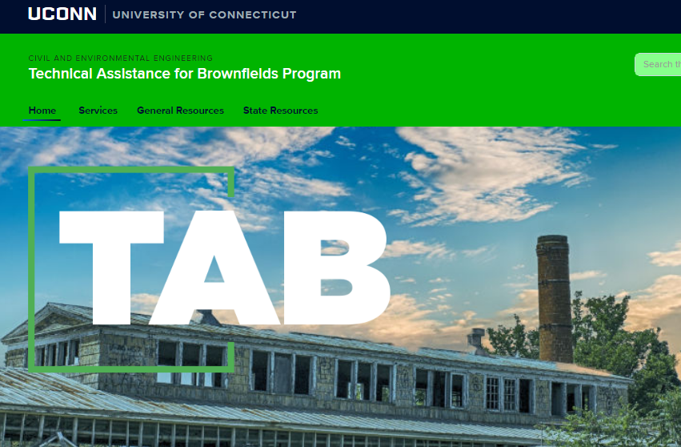
https://tab.program.uconn.edu/

Slide 4
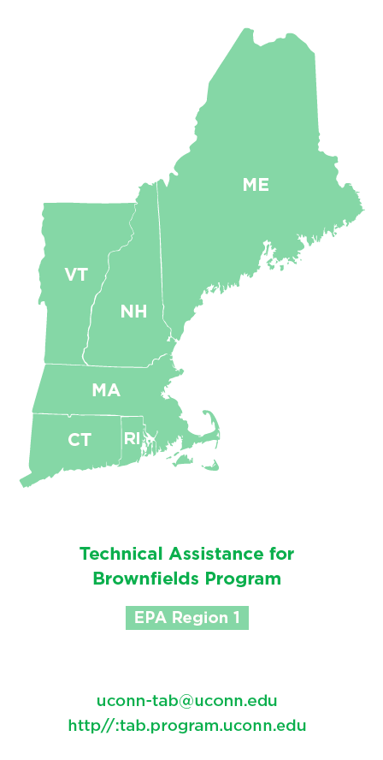
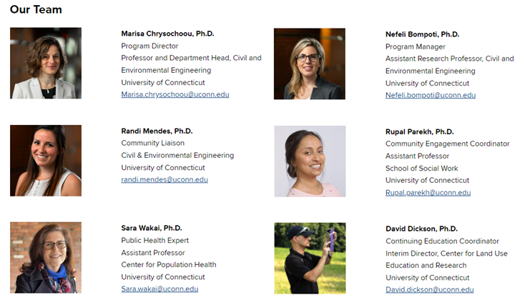
UCONN TAB

Slide 5
Our services at a glance
Direct Technical Assistance
Continuing Education
Municipal Assistance Program
Community Engagement
uconn-tab@uconn.edu

Slide 6
Direct Technical Assistance
Technical Document Review
Summary of Environmental Site Assessment Reports, Remedial Action Plans, Planning Documents
Brownfields Proposals Review
EPA Brownfield Program proposals (assessment, cleanup, multipurpose, RLF, Job Training), and State Program proposals
Access to Resources
Fact sheets, example proposals, and documents
Online Office Hours
Answer Technical Questions

Slide 7
Municipal Assistance Program
Sep-Dec
Jan-April
May-Aug
MARC Grant support
TECHNICAL SUPPORT
Target Area and Brownfield Site Description
Community Need (Demographics, EJSCREEN data)
Brownfield inventories
Collect data for brownfield sites
Data Review and Gap Analysis for brownfield sites
Draft Scope of Work for site investigations
Site reuse planning
Community Engagement Planning and Materials

Slide 8
Equitable Development
Healthy & Sustainable Communities
Public health
Energy efficiency & renewable energy
Stakeholder Engagement & Training
Water Quality
Climate resiliency and adaptation
Sources of Pollution (brownfields, illegal dumping)

Slide 9
Leveraging Environmental Justice Funding
Community-based Nonprofit Organizations (CBOs)
Environmental Justice Collaborative Problem-Solving (EJCPS)
States and Tribes, local governments
Environmental Justice Government-to-Government (EJG2G)
Address an environmental and/or public health issue and the community’s leadership in formulating goals
Create model state, tribal, local, and territorial government activities that lead to measurable environmental or public health results in communities disproportionately burdened by environmental harms and risks

Slide 10
Environmental Justice Grants
Program | Eligible Entities | Partnerships | Award Funding | Number of Awards Anticipated
EJCPS | CBOs | Not required but strongly encouraged (if partnering with other CBOs letter of Commitment w/ subaward) | $500,000 $150,000 (small CBOs) | 83 total 50 for $500K projects 33 for $150K projects
EJG2G | State & Tribes State Instrumentalities Local Governments | Required w/ CBOs Strongly encouraged to have 3 partnerships (Letter of Commitment w/ subaward) | $1,000,000 | 70

Slide 11
Deadline for Applications
April 14, 2023
Cooperative Agreement Start Date: December 1, 2023
Performance Period:
3 years

Slide 12
Target Environmental Issues (both EJCPS & EJG2G)
Pollution Prevention, Monitoring & Remediation | Climate resiliency and adaptation | Facilitating engagement of disadvantaged communities
Air quality & asthma (Diesel reduction; emissions reduction; Reducing asthma) | Stormwater issues and green infrastructure | Environmental job training
Water quality and sampling | Emergency preparedness and disaster resiliency | Youth development relating to Environmental Justice
Lead contamination (lead abatement) | Food access to reduce vehicle travel and fuel emissions
Illegal dumping (hazardous waste; community cleanups)
Healthy Homes
Pesticides and other toxic substances

Slide 13
Example Projects (both EJCPS & EJG2G)
Address environmental/health issue in underserved communities/vulnerable populations
Cleanup of nonhazardous trash/illegal dumping
Reduction of lead (blood lead level testing, surveillance, restoration at schools and daycares)
Development of Citizen Science Monitoring programs
Planning and development of heat island mitigation strategies (cool roofs/walls, green roofs, cool pavements, permeable pavers, urban forestry initiatives, and extreme heat activities)
Efforts to improve equitable transportation to encourage walking, biking, and public transportation (bike share programs and bike storage facilities)
Energy efficiency, electrification, and renewable energy programs in K-12 schools (maintenance of HVAC systems, energy audits, energy system upgrades, installation of on-site renewables and/or green infrastructure indoor air quality monitoring and employee training)
Planning and development of environmental justice mapping tools or methodologies to determine potential impacts to underserved communities
Emergency preparedness and disaster resiliency plans to minimize exposure to pollutants (hurricanes, tornadoes, coastal flooding, oil spills, wildfires, and earthquakes)
Monitoring, prevention, and remediation of air quality issues related to living close to transportation networks (railroads, railyards, ports, heavily trafficked roadways)
Monitoring, prevention, and remediation of source releases of waterborne pollutants
Establishment of collaborative efforts, processes, and communication strategies between state agencies and local governments regarding ongoing environmental monitoring, prevention, or remediation projects.

Slide 14
EJCPS & EJG2G2 Eligible Project Activities (Project Type)
EJG2G only:
Smaller scale land purchases and/or acquisitions (Note: Only projects that represent less than half of the requested project funds are allowable)

Slide 15
Health Impact Assessments (special consideration under both programs)
Determine the potential effects of a proposed environmental decision (e.g., policy, plan, program, project, action) on the health of underserved and vulnerable communities and the distribution of those effects within the communities.
Example: Health Impact Assessment at German Gerena Community School - public elementary school in Springfield, MA
https://www.epa.gov/sites/default/files/2015-10/documents/final_gerena_school_hia_report.updated.508compliant.pdf

Slide 16
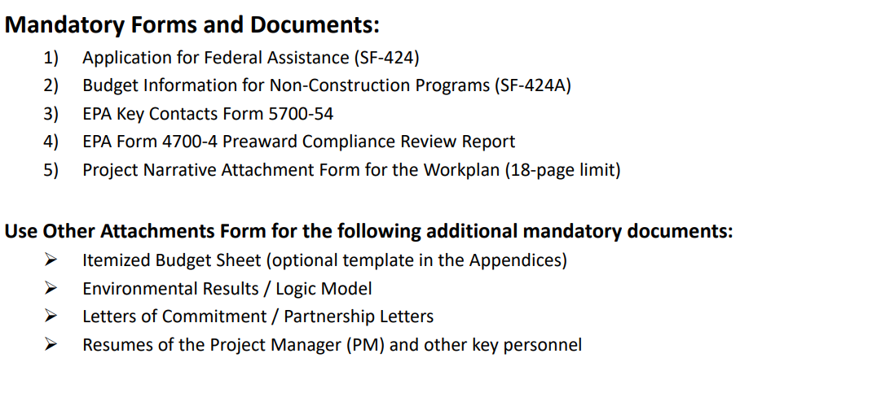
Application Package
Use EPA’s template for Workplan
EJCPS
Use EPA’s template for Workplan
EJG2G
EPA Pre-application Assistance Webinars

Slide 17
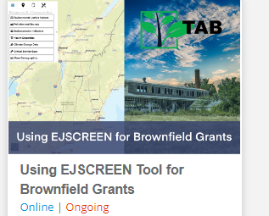
Environmental and Public Health Issues of Underserved Communities (12 points under Workplan)
EJCPS
Environmental and Public Health information of the Underserved Community
EJG2G
Disproportionate Environmental and Public Health Issues Impacting Underserved Communities
EJSCREEN Short Course
https://uconn.geniussis.com/Registration.aspx?AffiliateID=4D9KE1

Slide 18
Contacts
Tab.program.uconn.edu

Slide 20
Environmental Protection Network
550+ EPA alumni across the country
Advancing progressive national policies
Educating Congress
Resource to press and NGOs
Recruiting and retaining greater diversity at EPA

Slide 21
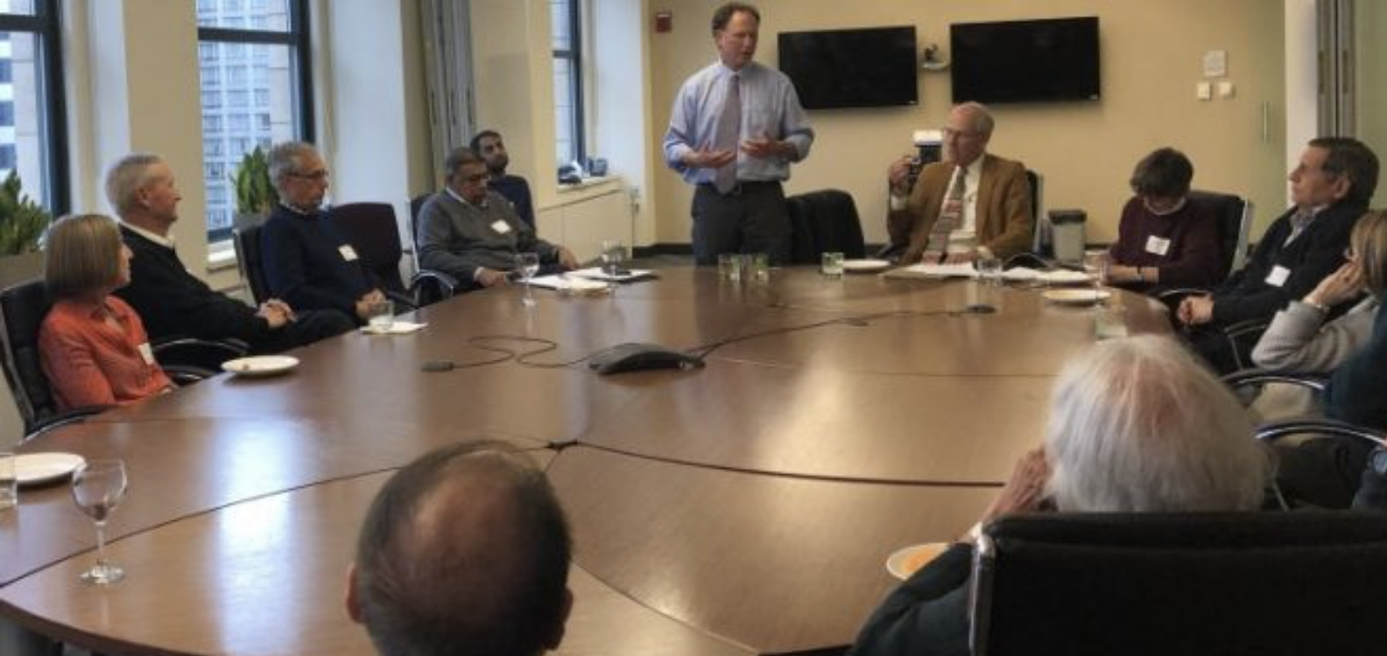
Pro Bono Technical Assistance
Bridge divide between communities and government
Former engineers, scientists, lawyers, permit writers
Communities and the NGOs who support them
Navigate regulations, data, policies
Achieve tangible public
health benefits

Slide 22
Types of Assistance
Translate documents into lay language
Navigate regulatory and grants programs
Identify individual contacts at agencies
Connect groups with others
Share lessons learned
Notes:
Talking Points

Slide 23
Brownfields Technical Assistance
TXHEA
Bayview Hunters Point
The Sustainability Lab
CCLR
Law clinics
Columbia Riverkeeper

Slide 24
Progress to Date
Engaged with 107 unique volunteers across 178 communities/organizations/law clinics,
Responded to 212 inquiries
Made 548 connections with our volunteers
Anticipate exponential growth
Brought on 5 new staff and more to come

Slide 25
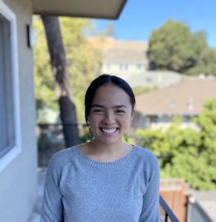
Community Outreach
Jasmine Wilkes
Regions 1 & 2
Kya Williams
Regions 3 & 4
Davina Resto
Regions 5 & 7
Mitchelle Mukeli
Regions 6 & 8
Jamie Zwaschka
Regions 9 & 10

Slide 26
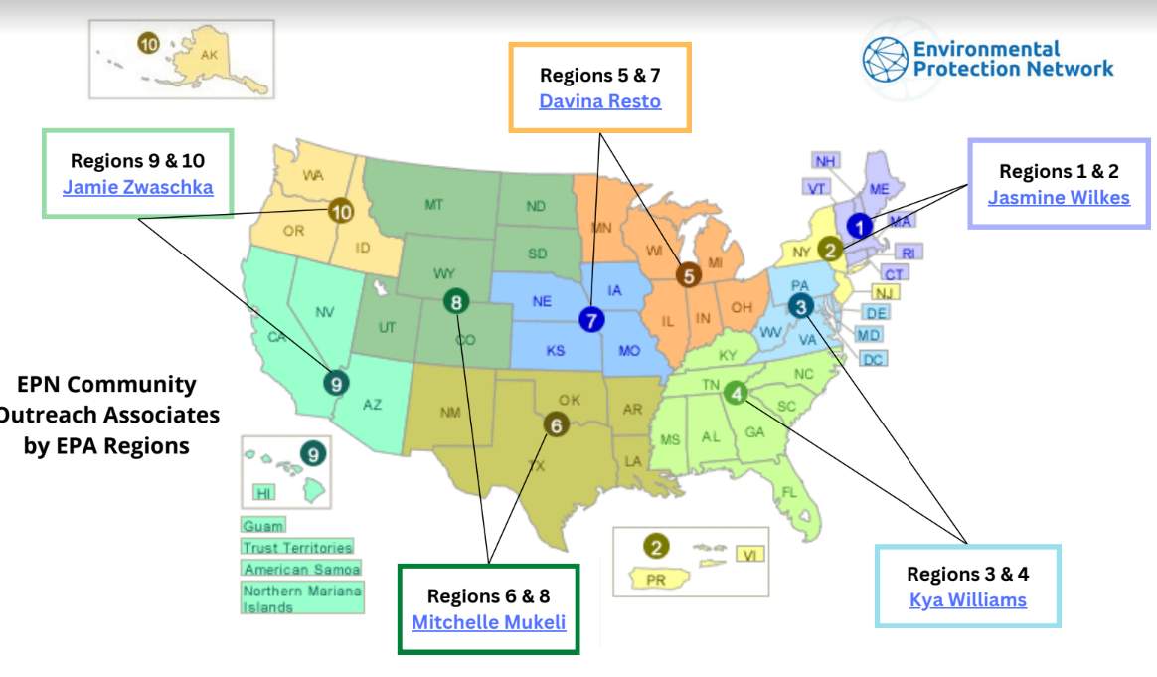

Slide 27
Kya Williams, Senior Community Outreach & Development Associate
kya.williams@environmentalprotectionnetwork.org
757-618-3027

