Slide 1
Preparing for EPA MARC Grants
Technical Assistance for Brownfields Program
EPA Region 1
Marisa Chrysochoou, Program Director
Tab.program.uconn.edu

Slide 2
Notes:
Poll Title: Do not modify the notes in this section to avoid tampering with the Poll Everywhere activity. More info at polleverywhere.com/support How do you feel today? https://www.polleverywhere.com/multiple_choice_polls/nCUm0syorQjYUfLlrKtDt?state=opened&flow=Default&onscreen=persist

Slide 3
Notes:
Poll Title: Do not modify the notes in this section to avoid tampering with the Poll Everywhere activity. More info at polleverywhere.com/support How knowledge do you think you have to prepare a MARC grant application? https://www.polleverywhere.com/multiple_choice_polls/29n9AqW8ZIbDfu0syNAAf?state=opened&flow=Default&onscreen=persist

Slide 4
You on June 29th ….
I wonder whether multipurpose or cleanup is the right grant for us…

Slide 5
You on September 15th
Oh my God, is multipurpose or cleanup the right grant for us ?!?

Slide 6
Learning Objectives – at the end of this webinar, you will know how to
Identify MARC options for FY24
Evaluate if a site is eligible and ready for a Cleanup Grant
Identify criteria to select type of grant, Target Areas and Site(s) for Assessment Grants
Plan for additional training and find resources to prepare the proposal
Select the appropriate type of grant for your organization
Apply for sam.gov and grants.gov accounts

Slide 7
Learning Objectives – at the end of this webinar, you will know how to
Identify MARC options for FY24
Evaluate if a site is eligible and ready for a Cleanup Grant
Identify criteria to select type of grant, Target Areas and Site(s) for Assessment Grants
Plan for additional training and find resources to prepare the proposal
Select the appropriate type of grant for your organization
Apply for sam.gov and grants.gov accounts

Slide 8
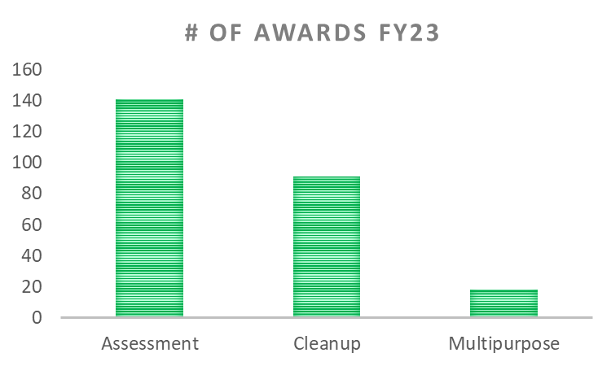
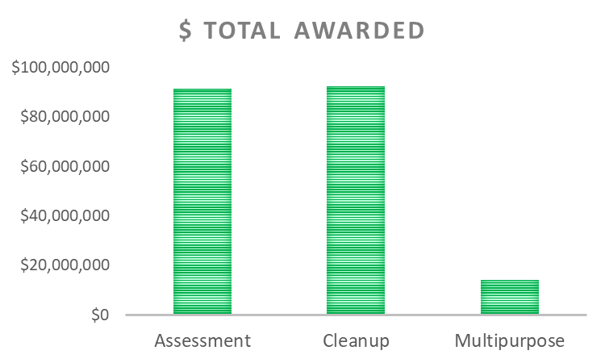
MARC grant Options FY24
Community-Wide and Coalition Assessment
Cleanup
Multipurpose

Slide 9
Notes:
Poll Title: Do not modify the notes in this section to avoid tampering with the Poll Everywhere activity. More info at polleverywhere.com/support What type of MRC grant are you considering? https://www.polleverywhere.com/multiple_choice_polls/J6TcXyC6fZZu2ROqbBxAv?state=opened&flow=Default&onscreen=persist

Slide 10
Learning Objectives – at the end of this webinar, you will know how to
Identify MARC options for FY24
Evaluate if a site is eligible and ready for a Cleanup Grant
Identify criteria to select type of grant, Target Areas and Site(s) for Assessment Grants
Plan for additional training and find resources to prepare the proposal
Select the appropriate type of grant for your organization
Apply for sam.gov and grants.gov accounts

Slide 11
Which grant is right for my organization?
Assessment
Multiple sites with no Phase I or II assessment
Sites can be privately owned – access agreement will be needed to conduct the work
Cleanup
Single site OWNED BY YOUR ORGANIZATION with Phase II assessment done
Assessment of Brownfield Cleanup Alternatives by consultant
Multipurpose
Multiple sites at different stages of characterization
Typically in a single Target Area or Town
Can be in one or multiple Target Areas (including multiple towns for regional entities)
General idea of site reuse plan
At least one site OWNED BY YOUR ORGANIZATION with at least partial Phase II

Slide 12
Learning Objectives – at the end of this webinar, you will know how to
Identify MARC options for FY24
Evaluate if a site is eligible and ready for a Cleanup Grant
Identify criteria to select type of grant, Target Areas and Site(s) for Assessment Grants
Plan for additional training and find resources to prepare the proposal
Select the appropriate type of grant for your organization
Apply for sam.gov and grants.gov accounts

Slide 13
Cleanup Grants – Are you (i.e. the applicant) eligible?
Go to next slide
Do you own the site?
Yes
No, but I will own it by the time the grant is submitted
No
Did you conduct All Appropriate Inquiries (i.e. conduct a Phase I within 6 months prior to the purchase date?)
Yes
No
Will a Phase II be complete by the time you receive the funds for the cleanup?
Yes
No
Consider other grant or site

Slide 14
To submit a Cleanup grant you must have a…
ABCA
Analysis of Brownfield Cleanup Alternatives
Prepared by Environmental Professional
Required attachment for proposal
Reuse plan
Must have site redevelopment plan for the proposal
Demonstrate stakeholder and community involvement in plan development
Demonstrate plan alignment with town and regional development plans
Document outlining remedial alternatives and selected plan
May include cost estimates needed for the proposal
Consider displacement potential as part of the reuse plan

Slide 15
I have no site reuse plan. What do I do?
Assemble an Advisory Committee
Involve economic development, planning and zoning, environmental consultant, community champions
Review site data
Size and location, zoning, remedial restrictions
Review town planning documents
Identify priorities consistent with site features
Develop a menu of options for the site
Residential, commercial, mixed use, recreation/ open space
Obtain Community Feedback
Town meetings, charrette

Slide 16
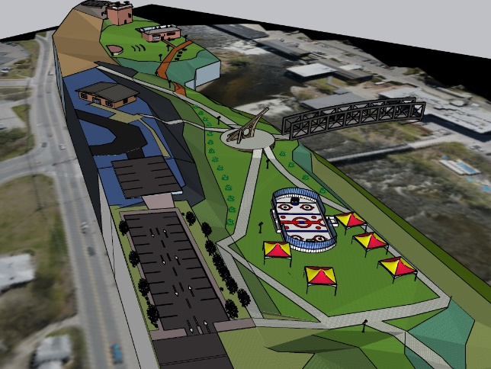
UConn TAB – Site reuse assessments
Property Information
Opportunities & Constraints
Market
Community
Local Economy
Regional Economy
Demographics
Land Availability
Strengths & Weaknesses
Expectations
Useable Acreage
Accessibility
Structures
Infrastructure
Utilities
Neighboring Land Use
Ownership
Land value
Tax status
Occupancy
Zoning
Visual rendering
Apply for our Municipal Assistance Program (Spring and Summer cycles)

Slide 17
Notes:
Poll Title: Do not modify the notes in this section to avoid tampering with the Poll Everywhere activity. More info at polleverywhere.com/support The City of Claremont, NH took a site under tax foreclosure in 2010. The Regional Planning Commission provided funding to conduct a Phase II investigation. Who is eligible to apply for an EPA Cleanup grant? https://www.polleverywhere.com/multiple_choice_polls/Rqd4MnD7UrPNy32N2OFCt?state=opened&flow=Default&onscreen=persist

Slide 18
Learning Objectives – at the end of this webinar, you will know how to
Identify MARC options for FY24
Evaluate if a site is eligible and ready for a Cleanup Grant
Identify criteria to select type of grant, Target Areas and Site(s) for Assessment Grants
Plan for additional training and find resources to prepare the proposal
Select the appropriate type of grant for your organization
Apply for sam.gov and grants.gov accounts

Slide 19
Types of Assessment Grants
Single applicant, all typical entities eligible (state, regional, town, EDCs, non profits, tribes)
$500K, 4 years
Lead applicant state, tribe or regional planning commission
Two to four additional members (towns, redevelopment agencies, non profits)
Each member must NOT have active MARC grant NOR MARC grant closed in 2015 or later
$1M, 4 years
Minimum 2 sites PER MEMBER
Must have formal agreement to attach to submission
Community Wide
Coalition

Slide 20
The chicken or the egg? Selection of Target Areas and Priority Sites
Identify sites across geographic boundaries
Map sites and identify clusters in one or more Census Tracts (Target Area)
Review area demographics compared to EPA criteria
Select sites in areas with underserved communities

Slide 21
Priority Site identification
Suggest to have at least two priority sites
Must meet brownfield definition (underutilized or abandoned, potential for contamination)
Can be privately owned
Applicant cannot be liable for contamination
Schools can be considered for hazardous building material surveys
Consult state brownfield coordinators and state lists

Slide 22
Example Middletown, CT (population 46,000)– 42 sq.mi., 11 census tracts
Notes:
This is the entire City of Middletown, encompassing 11 census tracts. The first step is to map the priority sites and see where they are located so you can pinpoint the census tracts and block groups of interest.
In this case Middletown chose to focus the grant on their Riverfront Area, so all four sites are close to each other and they are located within two census tracts. So let’s see how we can get data at the town level and the census tract level.
(Navigate to EJSCREEN)

Slide 23
City created five redevelopment areas with clusters of brownfields

Slide 24
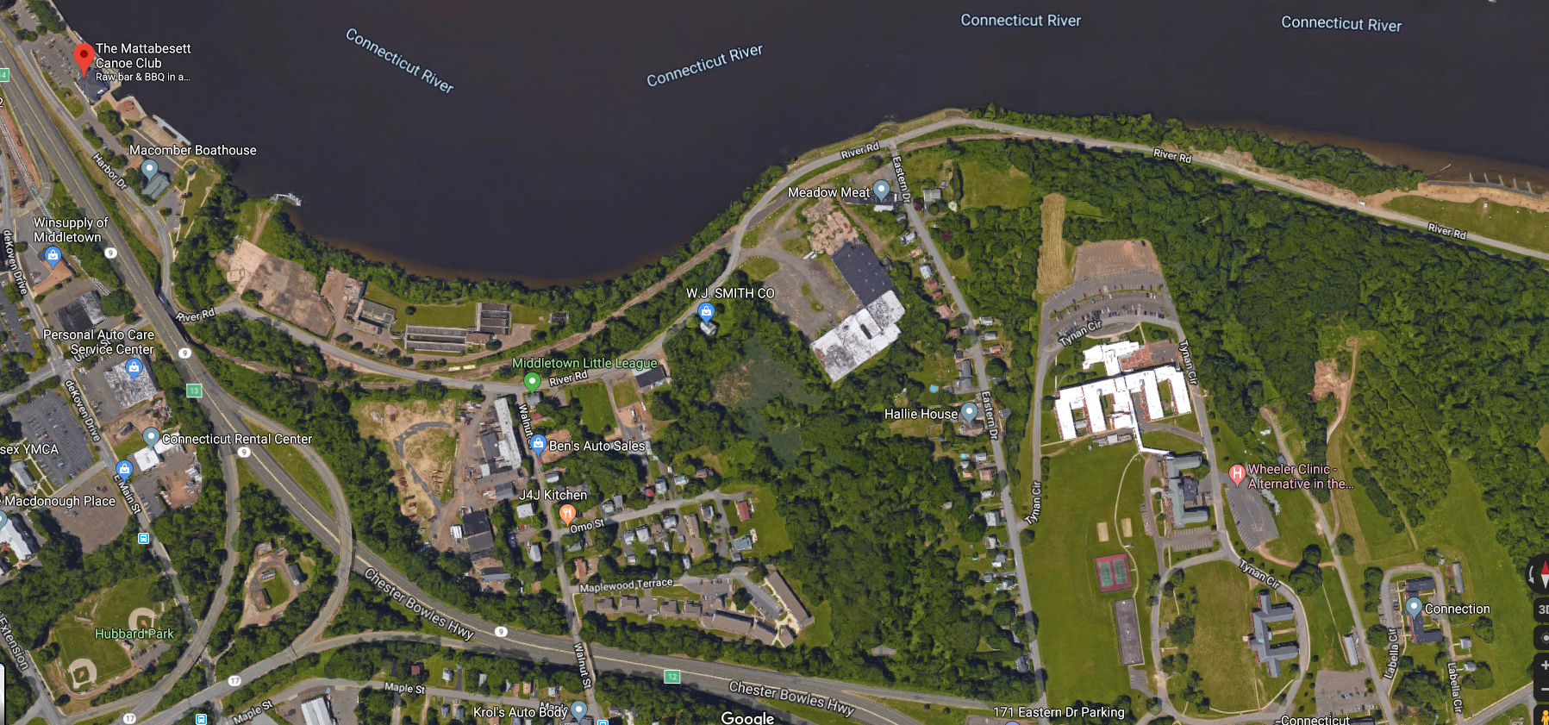
Riverfront Area Brownfields
$2.6M from DECD for assessment and conceptual design of this property
Sumner Brook
Sewage facility in use until Dec 19
Jackson site
Peters oil property
OMO site
Superfund site previous municipal dump-capped

Slide 25
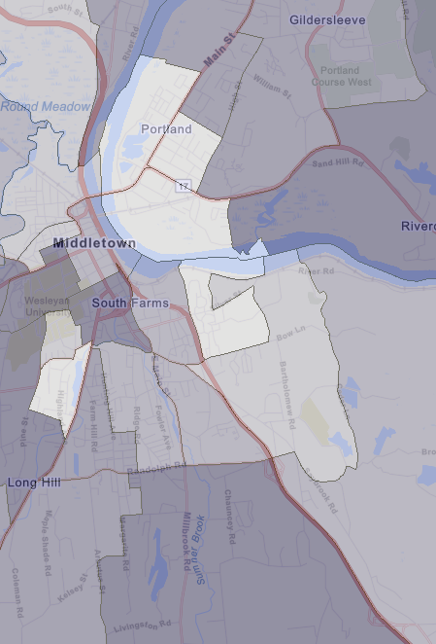
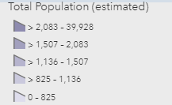
Final selection – Census Tracts 5416 and 5417
Neighborhoods surrounding priority sites, with ~5,000 people
Census tracts include Riverfront area

Slide 26
How do I get demographic data?
EJ SCREEN version 2.2 is coming…
Watch video on using the American Community Survey Platform on our Grant Resources page
Past webinar on EJ SCREEN available

Slide 27
Notes:
Poll Title: Do not modify the notes in this section to avoid tampering with the Poll Everywhere activity. More info at polleverywhere.com/support An community wide assessment grant cannot have more than one target area https://www.polleverywhere.com/multiple_choice_polls/xvks85FF5Q3j52hcNmzy3?state=opened&flow=Default&onscreen=persist

Slide 28
Learning Objectives – at the end of this webinar, you will know how to
Identify MARC options for FY24
Evaluate if a site is eligible and ready for a Cleanup Grant
Identify criteria to select type of grant, Target Areas and Site(s) for Assessment Grants
Plan for additional training and find resources to prepare the proposal
Select the appropriate type of grant for your organization
Apply for sam.gov and grants.gov accounts

Slide 29
Apply for sam.gov and grants.gov accounts
Step 1: Check with your organization; you most likely have both, unless you are a new non-profit organization
Step 2: Register for sam.gov
Step 3: Register for grants.gov
https://www.youtube.com/watch?v=n-aB763ohe8
https://www.youtube.com/watch?v=sj3X2XPAQ5g

Slide 30
Learning Objectives – at the end of this webinar, you will know how to
Identify MARC options for FY24
Evaluate if a site is eligible and ready for a Cleanup Grant
Identify criteria to select type of grant, Target Areas and Site(s) for Assessment Grants
Plan for additional training and find resources to prepare the proposal
Select the appropriate type of grant for your organization
Apply for sam.gov and grants.gov accounts

Slide 31
In person boot camps
CT, NH, ME (tentative)
Open to prospective applicants
Up to 10 participants
All day workshop (830 am to 3 pm)
Section by section preparation of the narrative
Target Area selection and description
Target Site Description
Reuse plans and benefits
Community Need
Community Engagement
Tasks and Budgets

Slide 32
Webinars
June 29th
Preparing for MARC Grants
August
EJSCREEN (new version coming up)
September
Public Health Data for MARC grants
October
Displacement and how to address it

Slide 33
Two stage grant review process – FY23 timeline
1st round October 25th
2nd round November 8th
Submission
November 22nd
Returned to applicants by November 1st
Returned to applicants by November 14th

Slide 34
Fall Municipal Assistance Program – Support with grant proposal preparation
Narrative Section I
Target Area Description
Site Description (you provide the sites)
Narrative Section II
Demographic data
Public Health data
Stakeholders
Community Engagement Plan
Cleanup and Multipurpose
Assistance organization of public meeting
Deadline is July 15th!!

Slide 35
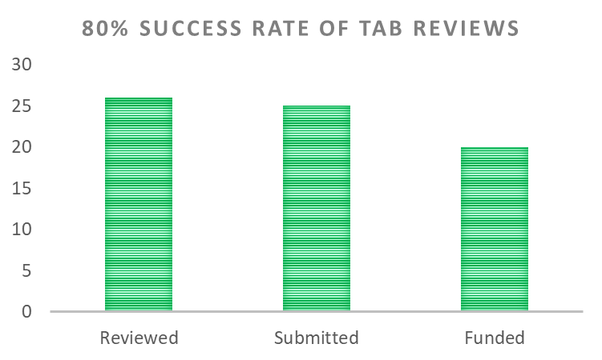
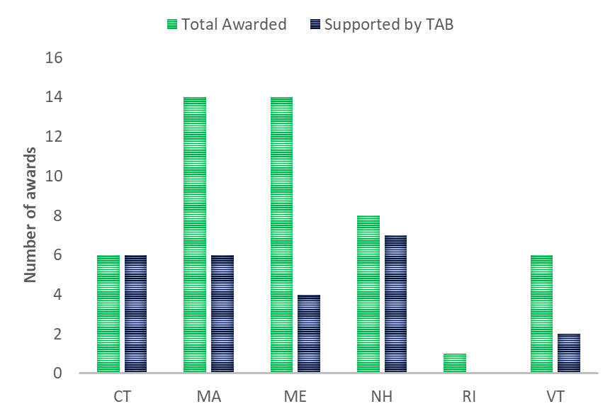
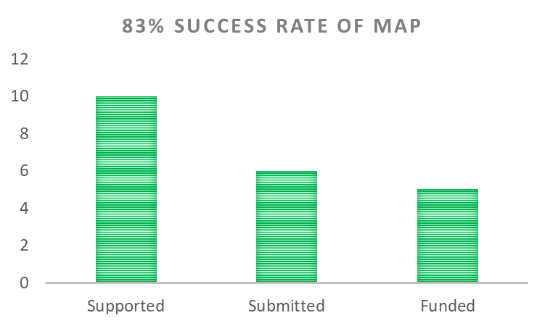
Our track record – FY23 MARC awards

Slide 36
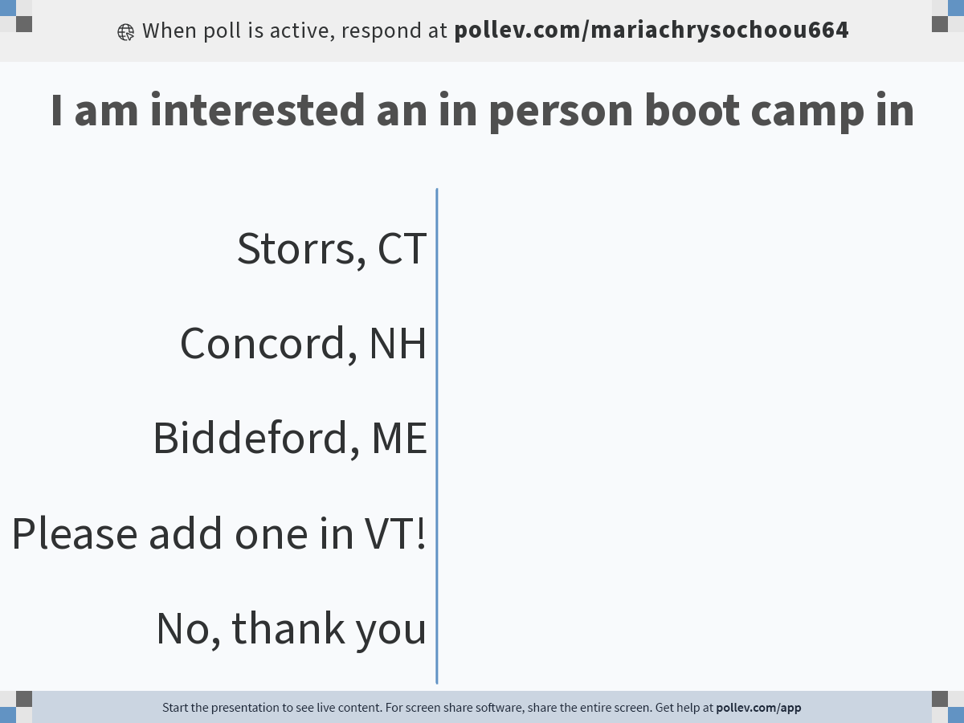
Notes:
Poll Title: Do not modify the notes in this section to avoid tampering with the Poll Everywhere activity. More info at polleverywhere.com/support I am interested an in person boot camp in https://www.polleverywhere.com/multiple_choice_polls/tVB23AQwVmOxNjpylUohL?state=opened&flow=Default&onscreen=persist

Slide 37
Notes:
Poll Title: Do not modify the notes in this section to avoid tampering with the Poll Everywhere activity. More info at polleverywhere.com/support This webinar provided useful knowledge for MARC grant preparation https://www.polleverywhere.com/multiple_choice_polls/JetI5zm5Io7f3OzIxyA9X?state=opened&flow=Default&onscreen=persist

Slide 38
Notes:
Poll Title: Do not modify the notes in this section to avoid tampering with the Poll Everywhere activity. More info at polleverywhere.com/support Please provide additional topics for future webinars https://www.polleverywhere.com/free_text_polls/PW18oewWkVHfcTCHs1uID

Slide 39
Questions? Email uconn-tab@uconn.edu

