Slide 1
Using EJSCREEN and CJEST for FY24 MAC Grants
Technical Assistance for Brownfields Program
EPA Region 1
Marisa Chrysochoou, Program Director
Tab.program.uconn.edu

Slide 2
Learning Objectives for today’s webinar
Understand geographic units in EJSCREEN and U.S. Census
Identify the difference between geographic boundary and Target Area for MAC grants
Generate maps and reports for your Target Area and community in EJSCREEN v2.2
Select the appropriate indicators for each subsection
Interpret the indicators to demonstrate Community Need according to the EPA evaluation criteria
Identify whether your site(s) are within a disadvantaged Census Tract using CEJST

Slide 3
Sections to use EJSCREEN
2a. Community Need
ii. Threats to Sensitive Populations
1. Health or Welfare of Sensitive Populations – 5
2. Greater Than Normal Incidence of Disease and Adverse Health Conditions – 5
3. Promoting Environmental Justice - 10
2a. Community Need points
ii. The Community’s Need for Funding
Determine whether your community is low-income
10/13 WEBINAR

Slide 4
Examples from successful grants in FY23
Multipurpose Grant, Claremont, NH (population 13,000)
Cleanup Grant, Diesel Power Plant, Caribou, ME (population 7,400)
Chittenden County Regional Planning Commission, VT (Burlington 45,000; Winooski 7,000)
Note: examples have been adjusted to address FY24 criteria using EJSCREEN v. 2.2; values and suggested narrative are NOT from the original proposals

Slide 5
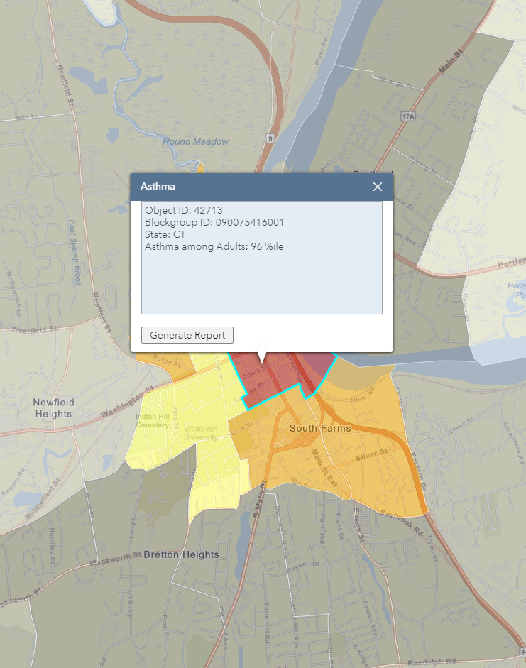
Geographic units in EJSCREEN
09
007
(5416)00
1
State
County
Census Tract
Block Group
Federal Information Processing Series (FIPS)
Frequently only the first four digits of the tract are used (when the last two digits are zero), except when it is 2511.01 and 2511.02 as two separate tracts
Reference maps for different demographic units can be obtained from the Census website in the following links
U.S. Census 2020 Reference Census Tract Maps
U.S. Census 2020 Reference Block Group Maps

Slide 6
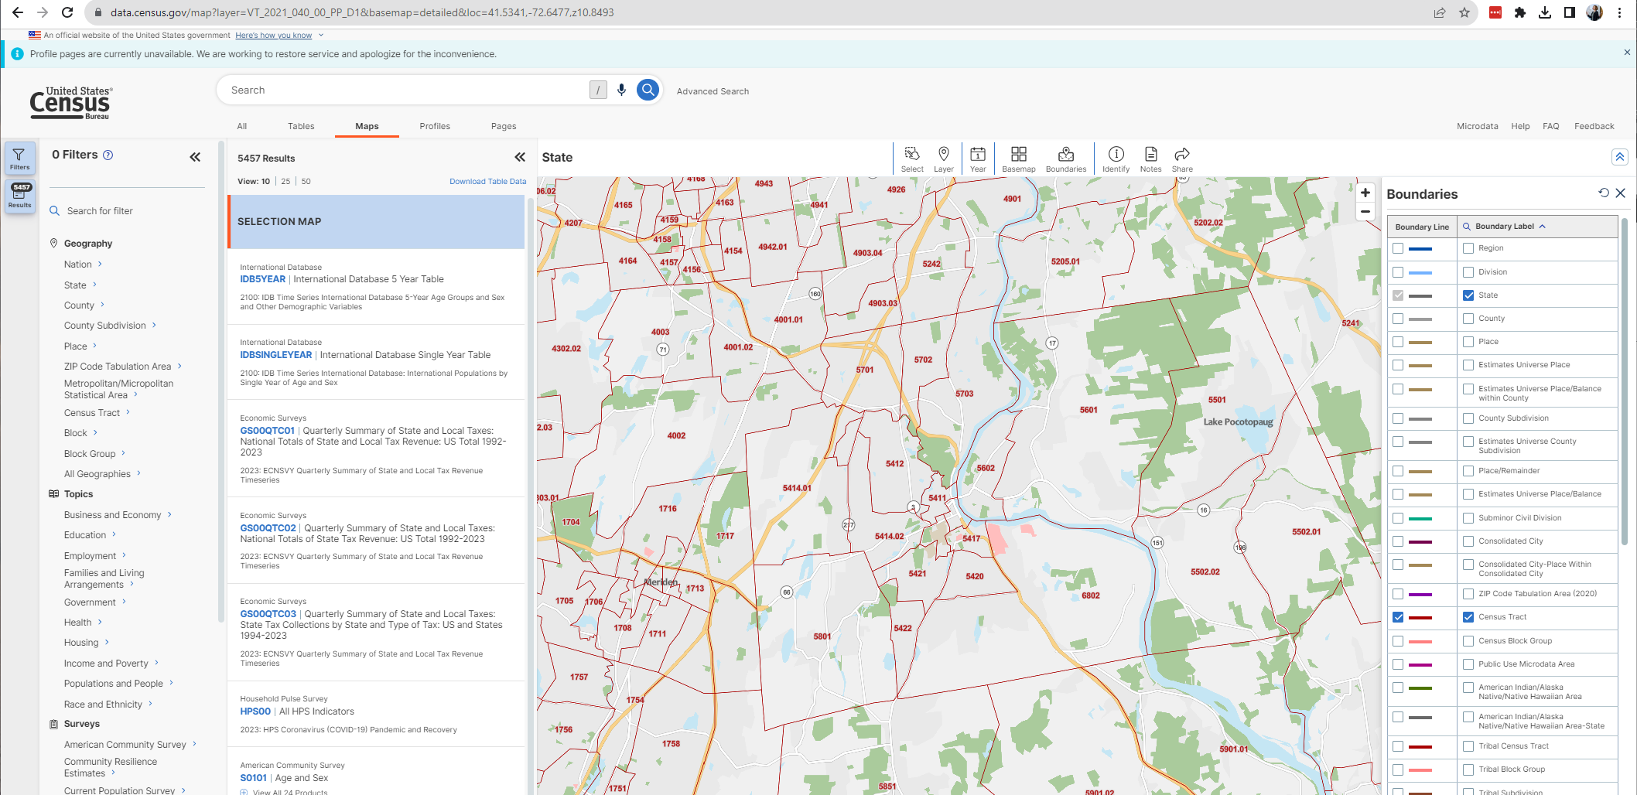
Viewing Census Tract numbers on Census website
NO way to search an address; you have to navigate using landmarks

Slide 7
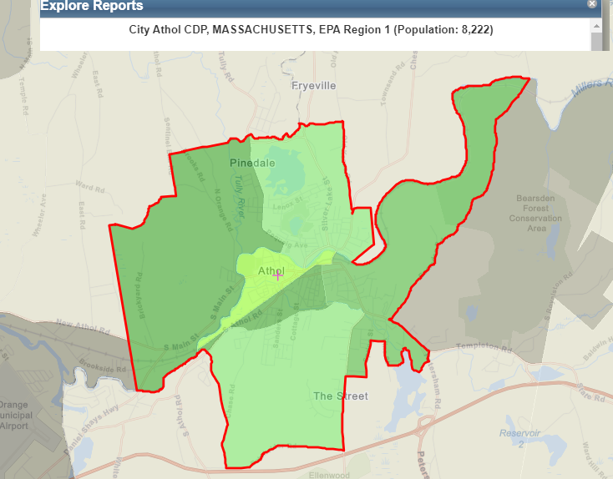
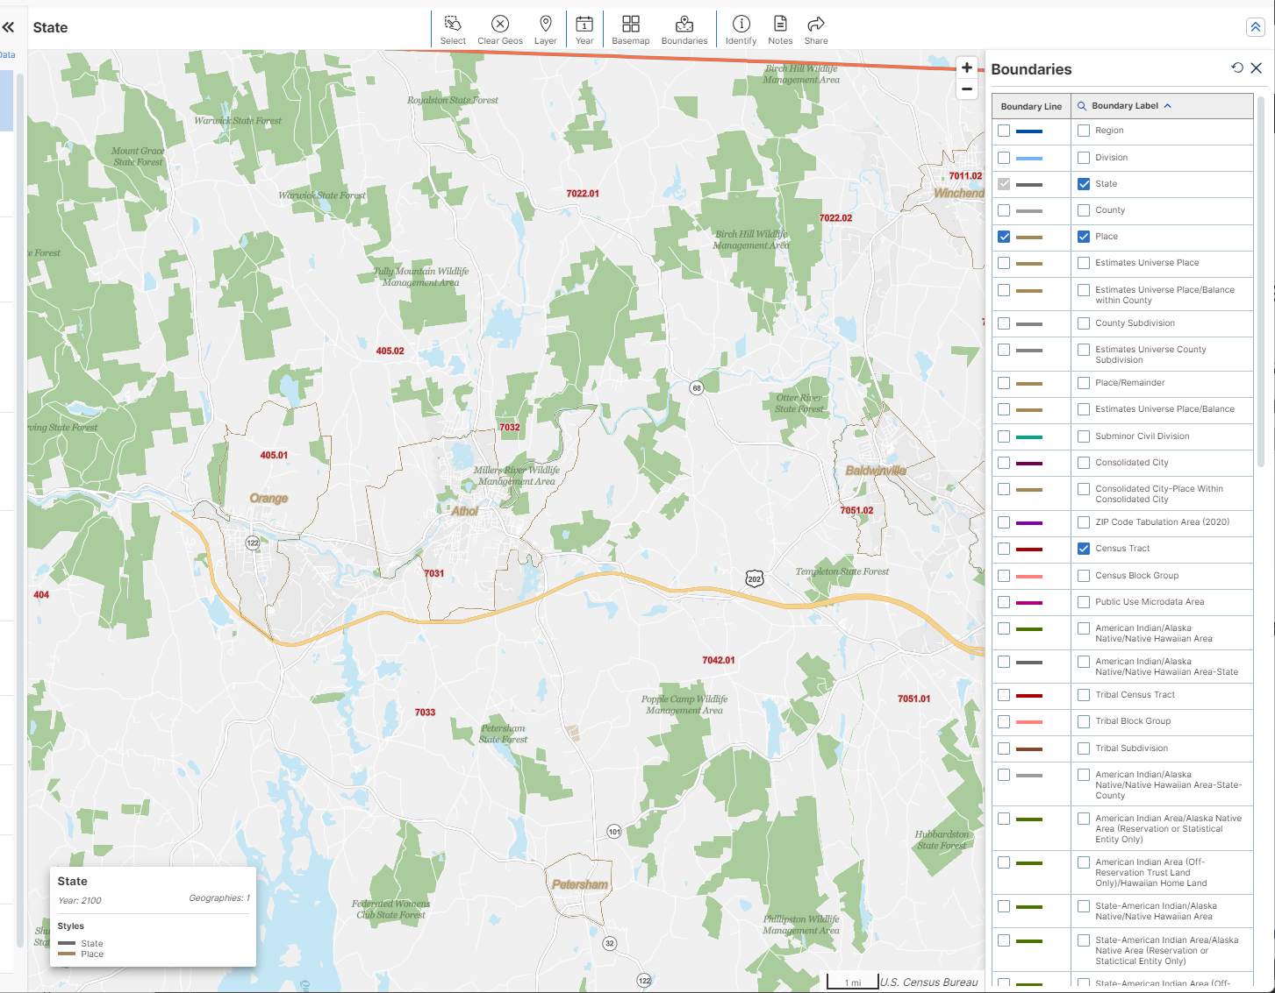
Special geographic units in EJSCREEN
CDP: Census Designated Place
statistical geographic entities representing closely settled, unincorporated communities that are locally recognized and identified by name
They are usually sub-parts of other census tracts, but their demographics are provided independently
You can visualize which cities have CDPs on the Census website

Slide 8
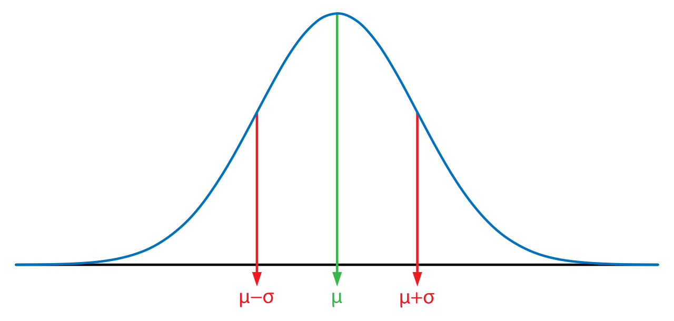
What are percentiles?
People’s height
0th percentile = everyone it taller than that
100th percentile = everyone is shorter than that
50th percentile = average height

Slide 9
Percentiles in EJSCREEN
National
Indices compared to every block group across the United States
State
Indices compared to the block groups across the particular state

Slide 10
Maps and Reports in EJSCREEN
Maps
Reports
Useful for obtaining all Demographic and Environmental Indices for your Target Area
Visual representation of indicators
All shown in Percentiles at the Block Group level
Can obtain in PDF or Excel format
Include raw values and percentiles for different geographic units
Useful for identifying the geographic units that are your Target Area

Slide 11
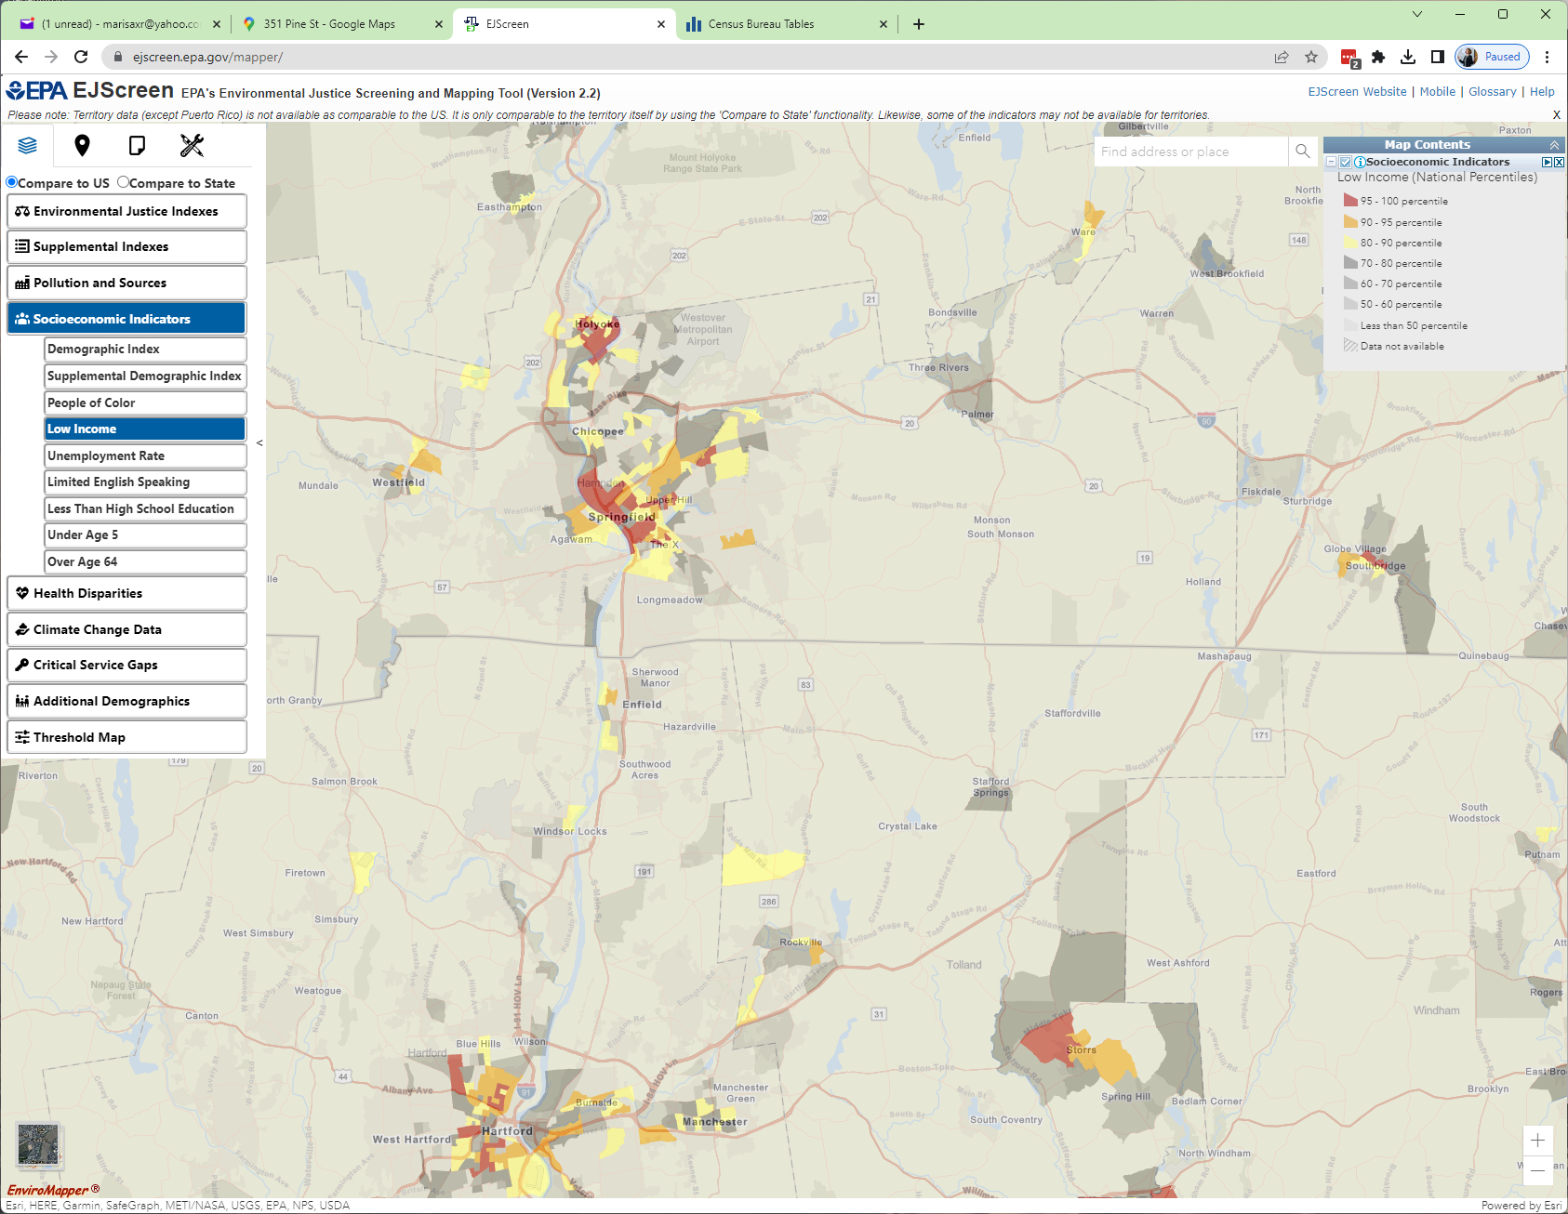
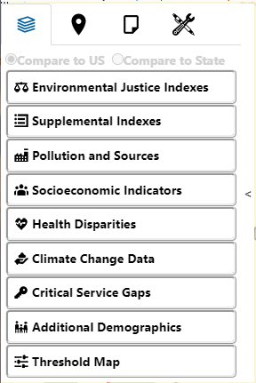
Maps in EJSCREEN
All maps per Block Group and in percentiles

Slide 12
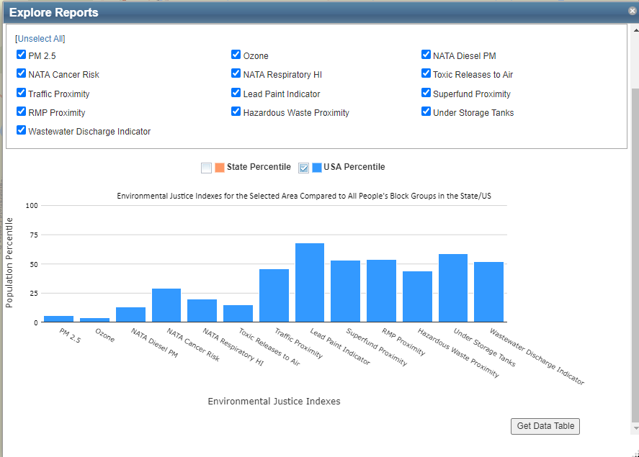
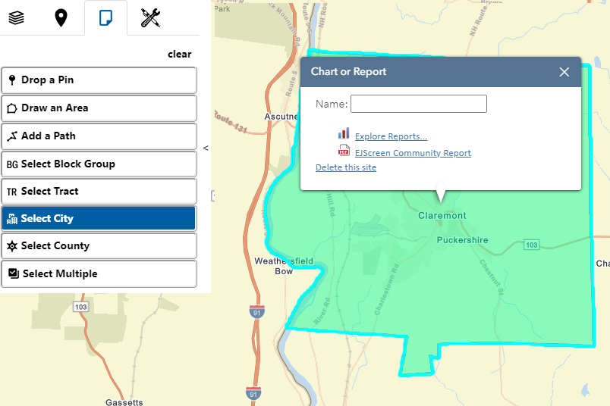
Reports in EJSCREEN
Reports are SPECIFIC to the unit you choose
generate Excel
generate PDF

Slide 13
What is geographic boundary versus a Target Area?
Geographic boundary: the area within which you can spend the grant funds (usually the entire town) -> applicable to Assessment and Multipurpose Grants only
Target Area: Census Tract(s) within the town where your priority sites are (for assessment and multipurpose) or your target site (Cleanup)

Slide 14
Define your Target Area
Cleanup Grants: can be the neighborhood (0.25-0.5 mile radius around site), the block group, or the census tract that contains that site for smaller towns
Community-Wide Assessment, and Multipurpose grants: can be one or more block groups or census tracts that contain the priority sites or even the entire town
For regional entities, it may be several towns

Slide 15
How to choose?
Identify the block groups or census tract(s) of your priority sites
Use the EJSCREEN maps to visualize key demographics and/or generate reports if you have two different Target Areas that include disadvantaged Census Tracts (e.g. a Census Tract versus a CDP)
Choose the Target Area that includes your sites and demonstrates the maximum need
Use the CEJST tool to identify disadvantaged Census Tracts

Slide 16
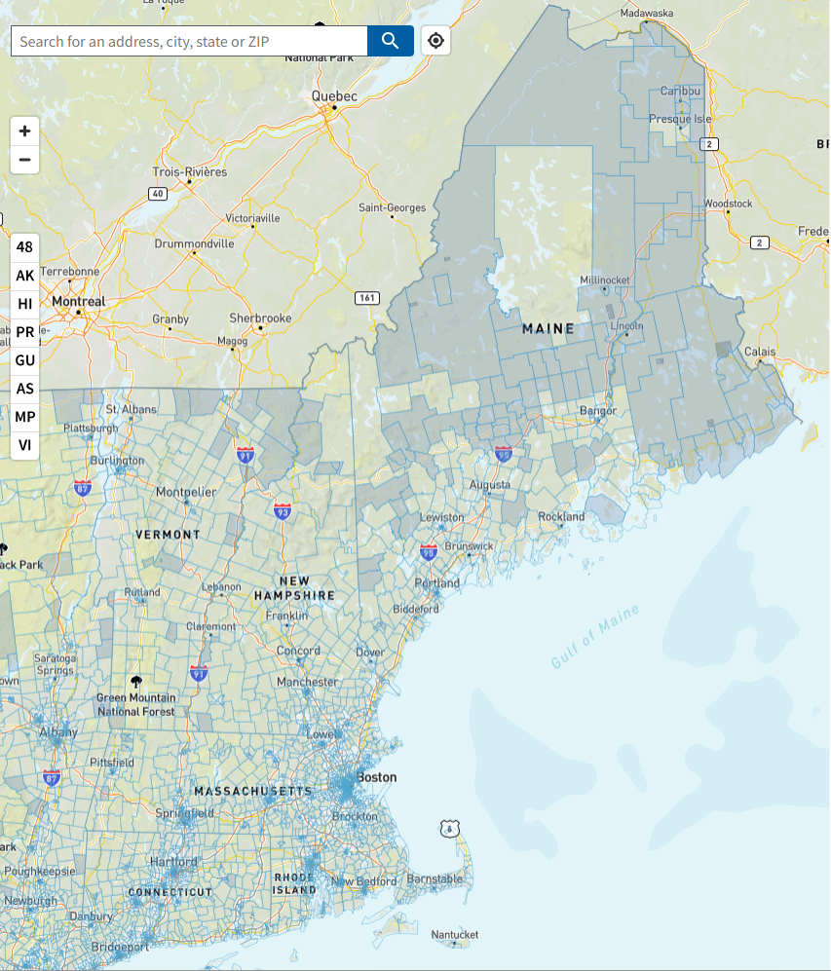
CEJST tool
Shows disadvantaged Census Tracts according to the methodology considering various demographic and eight categories of burdens
In FY24, the EJ criterion explicitly requires the identification of the Target Area as disadvantaged or not (worth 3 points)
Disadvantaged Census Tracts in New England

Slide 17
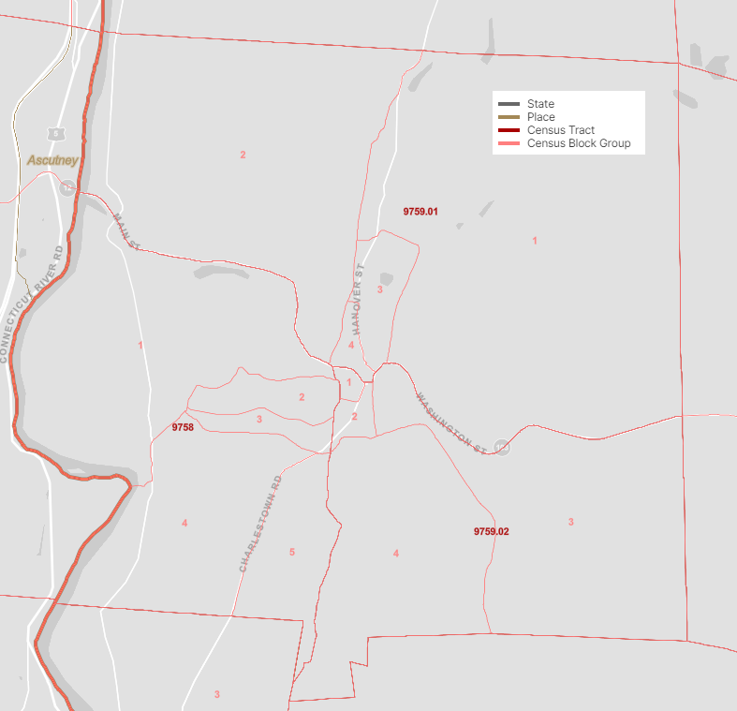
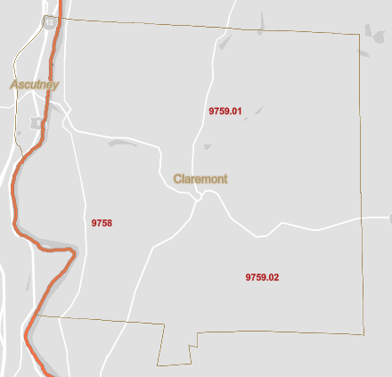
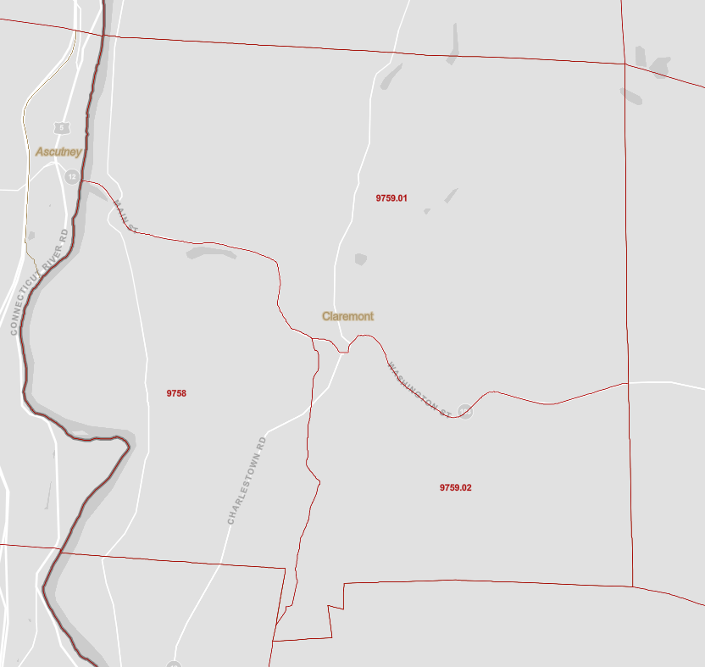
Example – Multipurpose Grant, Claremont, NH
Single site for assessment and cleanup in CS 9759.01
CEJST – only 9759.02 disadvantaged CS
Notes:
This is the entire City of Middletown, encompassing 11 census tracts. The first step is to map the priority sites and see where they are located so you can pinpoint the census tracts and block groups of interest.
In this case Middletown chose to focus the grant on their Riverfront Area, so all four sites are close to each other and they are located within two census tracts. So let’s see how we can get data at the town level and the census tract level.
(Navigate to EJSCREEN)

Slide 18
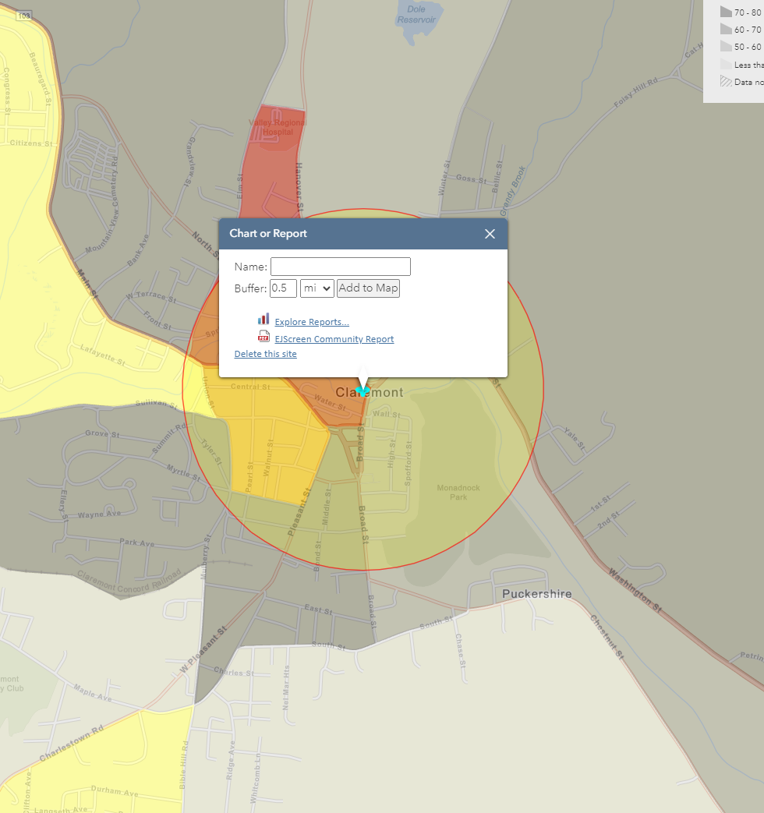
Example – Multipurpose Grant, Claremont, NH
Single site for assessment and cleanup
Geographic units (from larger to smaller)
Claremont CDP
Census tract 9759.01 (not disadvantaged)
Block Group 4 (not disadvantaged)
Alternative – 0.5 mile ring around site “neighborhood”, within CS 9759.02 (disadvantaged)
Notes:
This is the entire City of Middletown, encompassing 11 census tracts. The first step is to map the priority sites and see where they are located so you can pinpoint the census tracts and block groups of interest.
In this case Middletown chose to focus the grant on their Riverfront Area, so all four sites are close to each other and they are located within two census tracts. So let’s see how we can get data at the town level and the census tract level.
(Navigate to EJSCREEN)

Slide 19
Demographics for different geographic units
 | National Percentiles
 | 0.5 miles | Claremont CDP
Total Population | 2,645 | 12,955
People of Color Population | 25 | 17
Low Income Population | 89 | 72
Unemployed | 41 | 33
Limited English Speaking Households | 0 | 0
Population with Less Than High School Education | 77 | 66
Population under Age 5 | 89 | 62
Population over Age 64 | 48 | 63
Better numbers and includes disadvantaged CS -> best Target Area

Slide 20
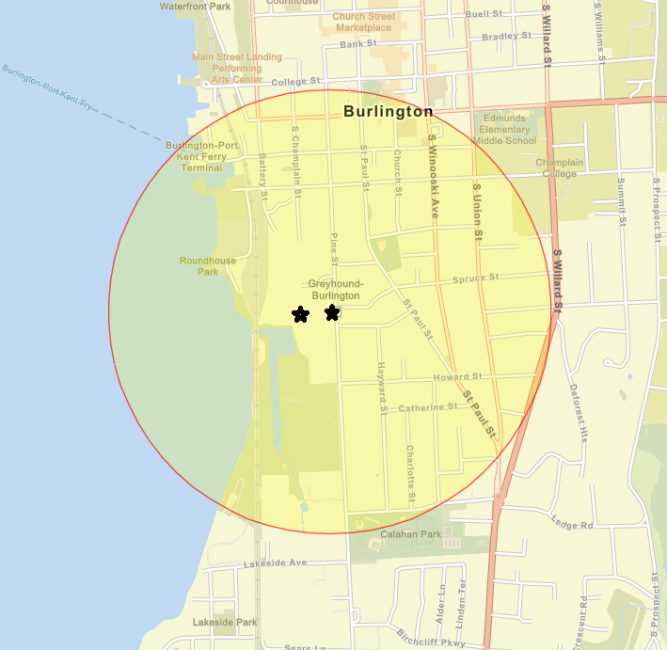
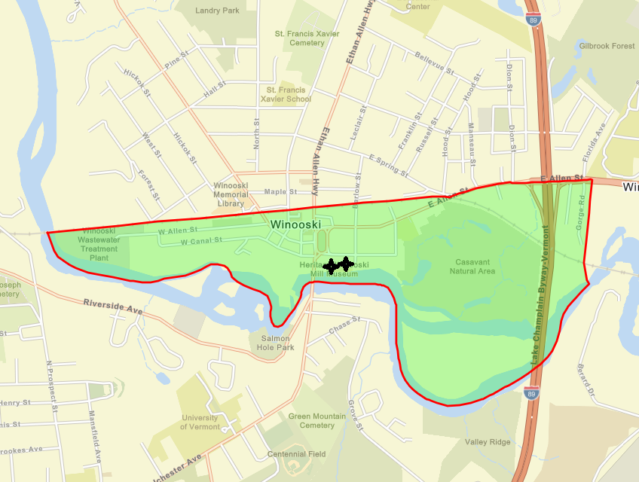
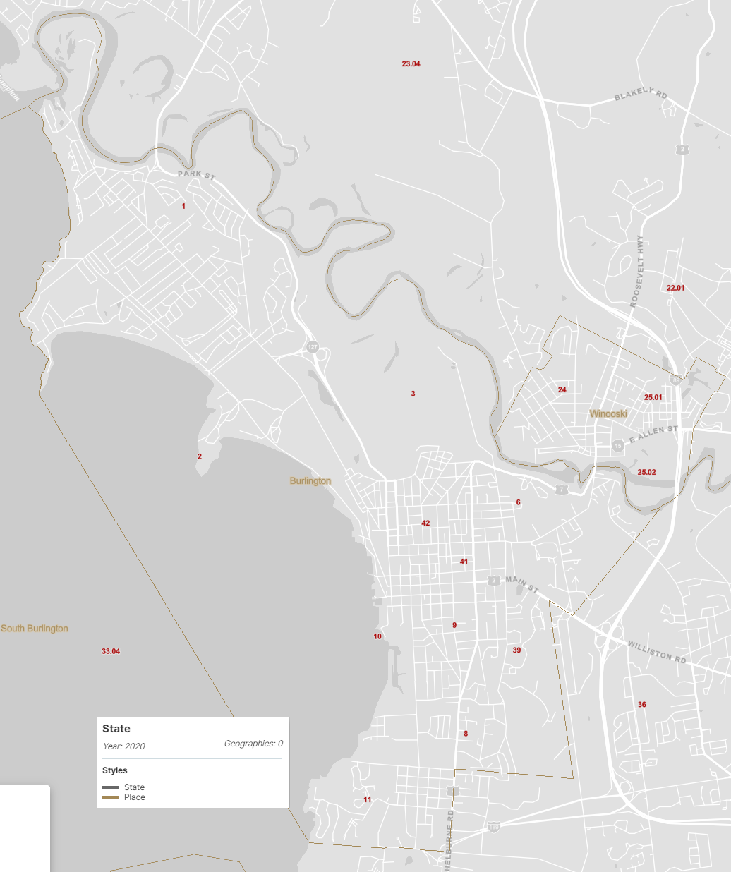
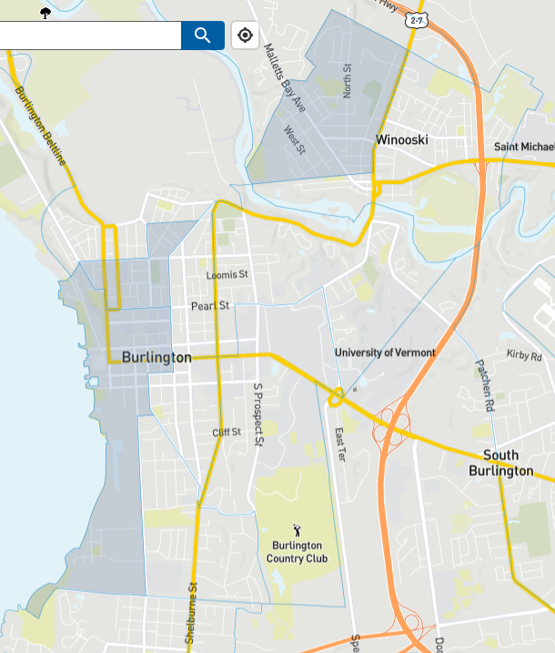
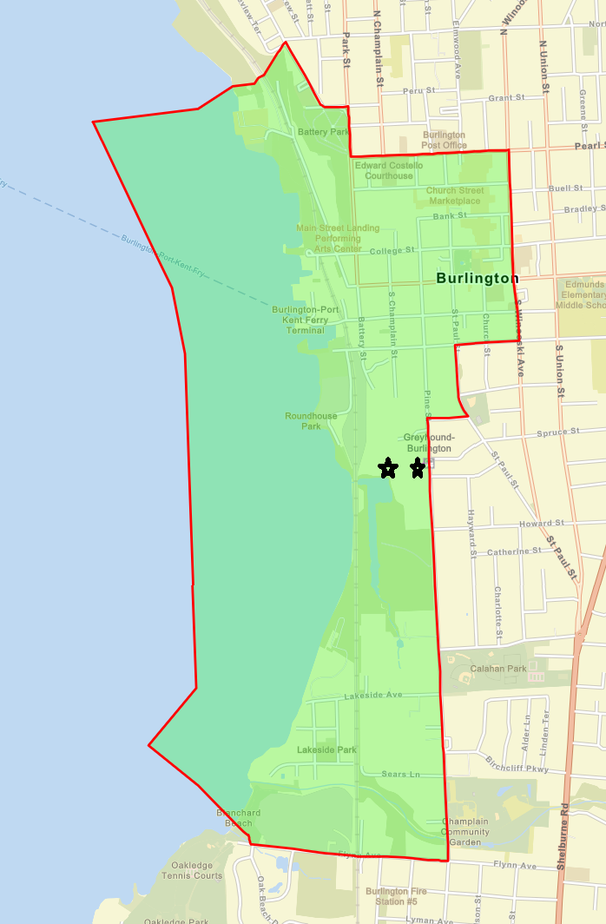
Chittenden RPC
Winooski Geographic Units
- CDP includes disadvantaged CS 24
- both priority sites in 25.02, not disadvantaged
CJEST
Burlington Geographic Units
- CDP– too large to be a Target Area
- Priority in CS 10, disadvantaged
- 0.5 mile radius around both sites, also includes CS 10

Slide 21
Demographics Table Chittenden
 | Winooski National Percentiles | Burlington National Percentiles
 | City | 0.5 miles | Census Tract
Total Population | 7,998 | 2,418 | 4,707
People of Color Population | 38 | 19 | 26
Low Income Population | 66 | 60 | 68
Unemployed | 43 | 38 | 46
Limited English Speaking Households | 76 | 57 | 57
Population with Less Than High School Education | 60 | 36 | 22
Population under Age 5 | 49 | 34 | 31
Population over Age 64 | 31 | 29 | 39
Better numbers
Final Target Area

Slide 22
Indicator application
Can use low-income population
if >50th national percentile
Supplement with median or mean household income and poverty levels
Suggest to use ACS data for that, but can also use EJSCREEN feature in comparison with the data below
2a. Community Need points
ii. The Community’s Need for Funding
Determine whether your community is low-income
2021 ACS | U.S. | CT | MA | ME | NH | RI | VT
Mean household income $ | 69,021 | 83,572 | 89,026 | 63,182 | 83,449 | 74,489 | 67,674
Median household income $ | 97196 | 120,670 | 123,174 | 83,914 | 108,061 | 97,908 | 89,820
Percent Population Below Poverty Level | 12.6% | 10.0% | 9.9% | 11.0% | 7.4% | 11.3% | 10.5%

Slide 23
EJ Narrative Criteria
2.a.ii. Threats to Sensitive Populations (20 points)
(1) Health or Welfare of Sensitive Populations (5 points)
The degree to which the sensitive populations within the target area(s) are clearly identified, the severity of the health or welfare issues experienced by the sensitive populations in the target area(s), and the extent to which this grant and reuse strategy/projected site reuse(s) will address those issues and/or will facilitate the identification and reduction of threats to the health or welfare of such groups.

Slide 24
Identify Sensitive Populations
EJSCREEN
People of Color
American Community Survey
Veterans
Low Income
Less than High School Education
Linguistically isolated
Age >65
Age <5
Persons with Disabilities
Look at all your demographic indicators
Choose the ones that exceed the 50th national percentile
  >50th mention if you don’t have much else
  >70th include
  >85th emphasize!!!
Supplement with State Percentiles if national percentiles are not very strong

Slide 25
Let’s go back to our examples
 | National Percentiles
 | Claremont 0.5 mile radius | Caribou CS 9514 | Winooski CDP | Burlington CS 10
Total Population | 2,645 | 2,280 | 7,998 | 4,201
People of Color Population | 25 | 32 | 38 | 13
Low Income Population | 89 | 74 | 66 | 76
Unemployed | 41 | 23 | 43 | 34
Limited English Speaking Households | 0 | 74 | 76 | 0
Population with Less Than High School Education | 77 | 46 | 60 | 66
Population under Age 5 | 89 | 89 | 49 | 37
Population over Age 64 | 48 | 78 | 31 | 75
Persons with Disabilities | 63 | 93 | 63 | 42
  >50th mention if you don’t have much else
  >70th include
  >85th emphasize!!!

Slide 26
Using State percentiles - example
 | National | State
 | Winooski CDP
Total Population | 7,998
People of Color Population | 38 | 92
Low Income Population | 66 | 81
Unemployed | 43 | 53
Limited English Speaking Households | 76 | 97
Population with Less Than High School Education | 60 | 84
Population under Age 5 | 49 | 60
Population over Age 64 | 31 | 14
Persons with Disabilities | 63
Winooski has a high population of low income (66th percentile nationally), limited English speaking (76th percentile) and persons with disabilities (63rd percentile). At the state level, there are several additional groups that are disproportionately represented in our Target Area (92nd percentile people of color and 84th percentile population with less than high school education.

Slide 27
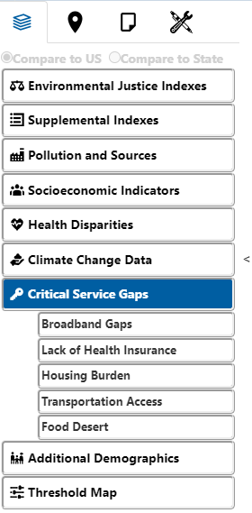
Health and welfare indicators in EJSCREEN
Reserve Cancer and Asthma for section (2)

Slide 28
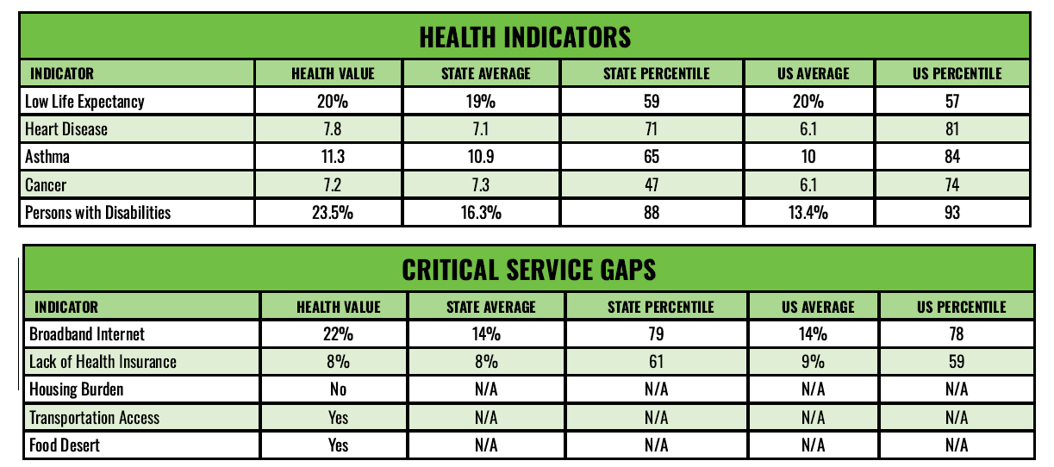
Health and Welfare Indicators in EJSCREEN Community Report – CS 9514, Caribou, ME
“Sensitive populations in the Target Area have lower life expectancy (57th percentile nationally), as evidenced by higher prevalence of heart disease (81st pct) and other health indicators; they also have less access to services such as health insurance (59th percentile) and Internet access (78th percentile)”.

Slide 29
EJ Narrative Criteria
(3) Environmental Justice (10 points)
(a) Identification of Environmental Justice Issues (5 points)
The extent to which the environmental justice issues affecting the underserved community(ies) or disadvantaged census tract(s) in the target area(s) are clearly described, and the severity of the environmental justice issues experienced by the underserved community(ies) or disadvantaged census tract(s) in the target area(s). (Note for all applications except those from Tribes or eligible Tribal entities, if none of the proposed sites identified in 1.a.ii. Description of the Proposed Brownfield Site(s) are located within a disadvantaged census tract according to CEJST, then the response may only earn up to 2 points.)
(b) Advancing Environmental Justice (5 points)
The extent to which this grant and reuse strategy/projected site reuse(s) will advance environmental justice and minimize the displacement of residents and/or businesses among the underserved community(ies) in the target area(s).

Slide 30
How to address 3(a)
First talk about the Target Area being in (or including) a disadvantaged census tract, which you determined when you selected the area
Then look at the EJSCREEN report for the particular Target Area and talk about the EJ indices and environmental indicators; add climate indicators from the Community Report as well

Slide 31
Promoting Environmental Justice
Demographics (Sensitive Populations)
Environmental Indicators (Sources of pollution)
EJ Indices

Slide 32

EJ Indices
$$EJ Index=Env. Indicator ×Demographic Index$$
$$\frac{\% People of Color+\% Low Income}{2}$$
$$Supplemental EJ Index=Env. Indicator ×Supplemental Demographic Index$$
$$\frac{\% People of Color+\% Low Income+\% Limited English+\% Less than Highschool+\% Low Life Expectancy}{5}$$
If you have a sensitive population that is NOT captured in the demographic indices (kids or elderly or persons with disabilities or veterans) then you have to discuss environmental indicators separately

Slide 33
Environmental Indicators
Definitions: https://www.epa.gov/ejscreen/ejscreen-map-descriptions#category-environmental
Air pollution indicators
Average annual daily traffic within 500 m
% pre-1960 housing
Proximity to other pollution sources (number within 5 km)
Within 1500 ft
Stream Proximity and Toxic Concentration

Slide 34
Evaluating Environmental Indicators – Caribou, ME
 |  | Value | State Avg. | %ile in State | USA Avg. | %ile in USA
Environmental | Particulate Matter (PM 2.5 in ug/m3) | 4.71 | 5.59 | 27 | 8.08 | 2
Environmental | Ozone (ppb) | 48.2 | 52.8 | 1 | 61.6 | 1
Environmental | Diesel PM (ug/m3) | 0.034 | 0.0745 | 20 | 0.261 | <50th
Environmental | Air Toxics Cancer Risk (risk per MM) | 10 | 17 | 0 | 25 | <50th
Environmental | Air Toxics Respiratory Hazard Index | 0.1 | 0.18 | 0 | 0.31 | <50th
Environmental | Toxic Releases to Air | 44 | 370 | 47 | 4600 | 16
Environmental | Traffic Proximity and Volume (daily traffic count/distance to road) | 14 | 66 | 55 | 210 | 20
Environmental | Lead Paint Indicator (% pre-1960s housing) | 0.5 | 0.37 | 76 | 0.3 | 73
Environmental | Superfund Proximity (site count/km distance) | 0.064 | 0.071 | 70 | 0.13 | 51
Environmental | RMP Proximity (facility count/km distance) | 0.079 | 0.21 | 56 | 0.43 | 21
Environmental | Hazardous Waste Proximity (facility count/km distance) | 0.069 | 1.1 | 27 | 1.9 | 14
Environmental | Underground Storage Tank Indicator | 0.22 | 0.68 | 61 | 3.9 | 32
Environmental | Wastewater Discharge Indicators (toxicity-weighted concentration/m distance) | 0.00029 | 0.002 | 69 | 22 | 38

Slide 35
EJ Indices versus Env Indicators – Caribou, ME
 | EJ Indices – consider demographics and pollution |  | EJ Indicators – consider only pollution sources
 | %ile in State | %ile in USA | %ile in State | %ile in USA
EJ Index for Particulate Matter 2.5 | 60 | 5 | 27 | 2
EJ Index for Ozone | 2 | 2 | 1 | 1
EJ Index for Diesel Particulate Matter | 49 | 4 | 20 | <50th
EJ Index for Air Toxics Cancer Risk | 0 | 6 | 0 | <50th
EJ Index for Air Toxics Respiratory HI | 0 | 5 | 0 | <50th
EJ Index for Toxic Releases to Air | 78 | 25 | 47 | 16
EJ Index for Traffic Proximity | 81 | 31 | 55 | 20
EJ Index for Lead Paint | 89 | 71 | 76 | 73
EJ Index for Superfund Proximity | 93 | 59 | 70 | 51
EJ Index for RMP Facility Proximity | 84 | 32 | 56 | 21
EJ Index for Hazardous Waste Proximity | 60 | 24 | 27 | 14
EJ Index for Underground Storage Tanks | 84 | 47 | 61 | 32
EJ Index for Wastewater Discharge | 89 | 47 | 69 | 38

Slide 36
Potential EJ Narrative – Caribou, ME
The Target Area (Census Tract 9514) is within a Disadvantaged Census Tract.
There is a high percentage of children, the elderly and low-income people in the area surrounding the site. The percentages of sensitive populations such as people with disabilities and veterans are also higher than the national average.
These populations live in old housing that increases likelihood of exposure to Pb paint, with the Pb indicator at the 73rd percentile nationally.
The proximity to Superfund sites and other sources of pollution (hazardous waste, USTs) also exceed the state average, which is unusual given the rural character of the region. This is reflected in higher than 80th state percentiles in six EJ Indices, all of which also exceed the national average.

Slide 37
Evaluating EJ Indices – Chittenden RPC, VT
 | Burlington CS10 , VT |  | Winooski CDP, CT
Selected Variables | %ile in State | %ile in USA | %ile in State | %ile in USA
EJ Index for Particulate Matter 2.5 | 89 | 13 | 93 | 15
EJ Index for Ozone | 87 | 6 | 93 | 8
EJ Index for Diesel Particulate Matter | 90 | 50 | 95 | 56
EJ Index for Air Toxics Cancer Risk | 77 | 25 | 90 | 33
EJ Index for Air Toxics Respiratory HI | 95 | 45 | 94 | 40
EJ Index for Toxic Releases to Air | 63 | 6 | 79 | 8
EJ Index for Traffic Proximity | 87 | 57 | 92 | 61
EJ Index for Lead Paint | 87 | 65 | 89 | 69
EJ Index for Superfund Proximity | 91 | 67 | 93 | 73
EJ Index for RMP Facility Proximity | 50 | 6 | 69 | 9
EJ Index for Hazardous Waste Proximity | 88 | 60 | 93 | 67
EJ Index for Underground Storage Tanks | 86 | 66 | 94 | 74
EJ Index for Wastewater Discharge | 82 | 39 | 94 | 61

Slide 38
Potential EJ Narrative – Chittenden RPC, VT
Both Target Areas include disadvantaged Census Tracts according to CEJST (CS 10 in Burlington, CS 24 in Winooski CDP). Both these areas have high levels of low income population with less than high school education; they also have amongst the highest state percentiles in terms of people of color.
These populations live in old housing (Pb paint national percentiles 69th and 65th for Winooski and Burlington, respectively) and are close to various sources of pollution (Superfund, Hazardous Waste, USTs). In Winooski, 12 out of 13 IEJ ndices exceed the 90th state percentile, and in Burlington, 10 indices exceed the 80th state percentile. More than half the EJ indices exceed national averages as well. Thus, these Target Areas are amongst the most affected by environmental injustice in the State of Vermont and are also EJ populations when compared to the U.S.

Slide 39
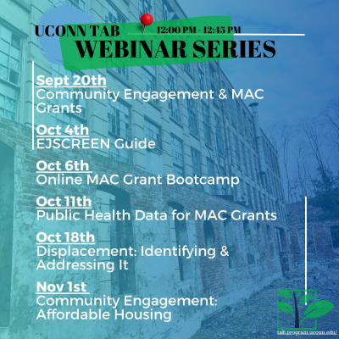
Additional resources
EPA EJSCREEN demonstration for Brownfields Grant Applications
EPA EJSCREEN Training page
Appendix in FY24 RFA FAQs
TAB Reviews
1st round deadline – 10/16
2nd round deadline – 10/30

Slide 40

s.uconn.edu/ejscreen23

