Slide 1
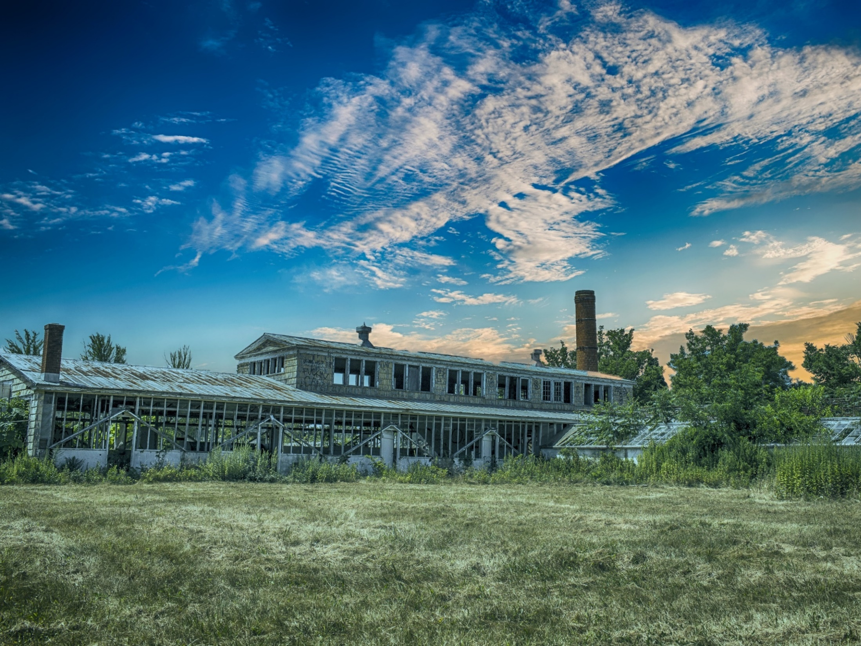
EPA MAC Grants: Displacement
Technical Assistance for Brownfields EPA Region 1
Katie Malgioglio, MSW: UConn TAB Community Liaison & Community Engagement Coordinator
Rupal Parekh, PhD: Assistant Professor, UConn School of Social Work & UConn TAB Community Engagement Coordinator
University of Connecticut
October 18, 2023
Notes:
Good afternoon, everyone (Rupal introduces herself, then Katie introduces herself)
We would like to Welcome you today's webinar on Identifying and Addressing Displacement in EPA MAC Grants. Thank you for joining us. Our goal today is to provide some education on displacement and help everyone here feel more comfortable writing about and talking about displacement – specifically in the context of brownfields grants and the brownfields redevelopment process.

Slide 2
Webinar Outline
MAC Grants
Displacement Overview
Definition
Brief Summary (who, what, where, when, why?)
Statistics & Impacts
Displacement & Brownfields
Grant-Writing Guidelines
Environmental Justice
Anti-Displacement Strategies
Grant Example
Questions
Notes:
In today's webinar, we'll be doing a brief overview of MAC Grants, defining displacement and summarizing the issue, giving examples of what it looks like and how it impacts communities, and how this all relates to the brownfields redevelopment process. We will also be going over the grant writing guidelines. More specifically, we'll look at Section 2a of the Narrative which discusses environmental justice and minimizing displacement. We will provide some pointers on writing that section and go into some specific anti-displacement strategies that you can write about on the grants and implement into your own communities. We'll have a few discussion questions along the way and conclude with an example of writing about displacement on the MAC grants. There will time at the end for a Q&A. (RP)

Slide 3
MAC Grants
Grant Type | Maximum Project Period | Award Funding | Number of Awards Anticipated
Community-Wide Assessment | 4 years | Up to $500,000 per applicant | 60
Assessment Coalitions | 5 years | Up to $1,500,000 per applicant | 26
Cleanup | 4 years | Up to $500,000, up to $2,000,000, or up to $5,000,000 per applicant | 65 (40 awards at $500,000 17 awards at $2,000,000 8 awards at $5,000,000)
Multipurpose | 5 years | Up to $1,000,000 per applicant | 20
Notes:
Community-wide assessment grants are for communities beginning to address their brownfields challenges and the funding can be used to assess multiple sites within a municipality, start a brownfields inventory, develop site-specific cleanup plans, or conduct community engagement efforts related to local brownfields sites.
Assessment Coalition Grants include several different partners. They must be led by the state, county government, or regional planning commission. Coalitions can include 2-4 communities or non-profit organizations that don't have the capacity to handle a brownfields grants themselves.
Cleanup grants are for communities with confirmed brownfields sites and people applying for this grant must be the owners of the site. Applicants can request 500,000, 2 million, or 5 million to cleanup one or multiple sites, but the awards for 500,000 are a lot more common and accessible.
Multipurpose grants are a bit harder to come by. They can use the funds for assessment and cleanup activities in a specific target area over a period of 5 years. EPA requires that the funds are used for a Phase II site assessment, a brownfield site cleanup, and the development of a reuse plan if you don't have one already. (RP)

Slide 4
What is Displacement?
Direct Displacement: occurs when residents are forced to relocate due to eviction, environmental hazards, or redevelopment of the buildings they live in
Indirect Displacement: occurs when residents can no longer afford to remain in their homes/neighborhoods due to increasing rents
Cultural Displacement: occurs when the character/culture of a neighborhood changes due to people leaving while new residents and businesses move in
Source: Thriving in Place
Notes:
We'll be talking about displacement in the context of neighborhoods and communities, and the first thing to know is that there are actually three different kinds of displacement: direct, indirect, and cultural.
Sometimes households are forced to move because they are evicted, facing environmental hazards in their neighborhood, or because of redevelopment projects where homes or apartment buildings are torn down to make way for new and more expensive development. We call this direct displacement—people who lived in these homes and neighborhoods are forced to relocate.
Indirect displacement occurs when households can no longer afford to stay in their homes because of increasing rents. When rents get too high for families, especially for people of color and low-income households, they may feel like they have no other choice but to move to more affordable neighborhoods. As a result, people lose access to their social networks, jobs, schools, places of worship, and other amenities that are important to them. (RP)
Direct and indirect displacement both lead to cultural displacement, which refers to broad, impactful neighborhood changes as people and businesses are priced out. In most cases, it is low-income populations, people of color, Black and Brown-owned businesses being forced to leave while higher-income, White residents move into the neighborhood and the businesses shift and change to meet their new customer base. Displacement also affects older people, and we see a lot of young, college educated professionals moving into these gentrifying neighborhoods.

Slide 5
Gentrification vs. Displacement
Displacement: the forced relocation of residents and businesses
Gentrification: neighborhoods changing when places of low real estate value are redeveloped, transformed, or “revitalized” into places of high real estate value (gentrification often attracts new businesses and new residents)
These two concepts are often connected (with gentrification leading to displacement) - but they do not have to be!
Notes:
People often get the terms gentrification and displacement confused or use them interchangeably, so we briefly wanted to clarify what exactly these words refer to. As we discussed in the last slide, displacement is the forced relocation of existing residents and businesses from their neighborhoods and communities. Gentrification is the process of neighborhoods changing when places of low real estate value are redeveloped or revitalized into places of high real estate value. This usually attracts new businesses and new residents, usually that are from higher-income backgrounds. Gentrification often leads to displacement, but it does not have to and that is why the EPA has put more of an emphasize on minimizing displacement this year in the grants. There is a big sentiment in these gentrified communities of "now that the neighborhood is nice, why can't I live here?"
The goal is not to stop gentrification or prevent our brownfields redevelopment projects from happening, but to be aware of the impacts that they can have, create an anti-displacement plan, and prioritize the needs of existing community members and small, local businesses. (RP)

Slide 6
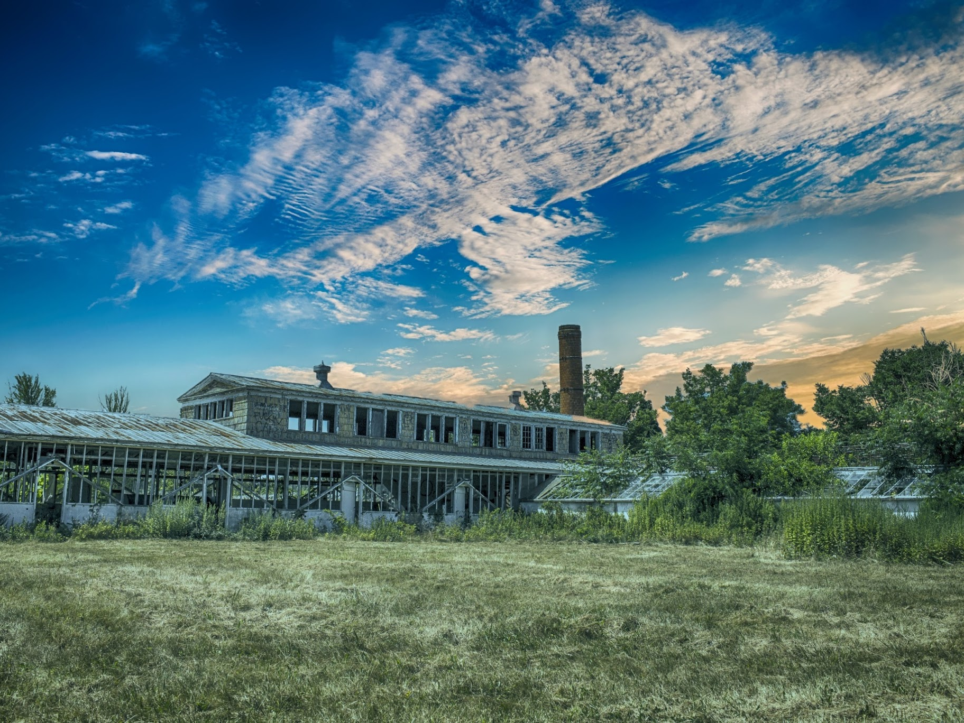
Have you seen gentrification and/or displacement in your communities? What was this experience like?
Notes:
So now we'd like to ask... (question on slide) (RP)

Slide 7
Cultural Displacement
What?
Who?
Where?
When?
Why?
Forced relocation of a community's existing residents and businesses
People of color, low-income populations, adults with no college degree, older adults, and families with children are most vulnerable to displacement
Displacement often occurs in urban areas and major cities
Displacement has been on the rise in the U.S. since the 1960s.
Main drivers of displacement: rising cost of living, lack of affordable housing, redlining, and neighborhood revitalization
Can be a result of gentrification, revitalization, redevelopment projects, etc.
New England examples: - Hartford, CT - Boston, MA - Providence, RI - Portsmouth, NH - Portland, ME - Burlington, VT
Notes:
This a basic overview of displacement and some the key points of the issue. So we already know that displacement is the forced relocation of a community's existing residents and businesses.
We haven't yet gone over who it impacts, and these include our typical sensitive populations. People of color, low-income populations, groups with low educational attainment, adults over 65, and families (especially single parent families) with young children are the most vulnerable to displacement.
Looking at where displacement occurs – it's most commonly in urban areas and major cities. In Connecticut, we see displacement in Hartford, in Bridgeport, in New Haven; in Rhode Island, Providence is very gentrified and seeing residents being displaced. Boston, Massachusetts is one of the most gentrified cities in the country. Displacement is everywhere, and New England is by no means immune. There have also been records of displacement in Portsmouth, NH, Portland, ME, and Burlington, VT. This is not a comprehensive list, just a few examples to put displacement in New England into perspective.
The term "displacement" was coined in the 1960s and it's been on the rise ever since, with lots of different examples throughout history. Displacement frequently occurs as a result of gentrification, revitalization initiatives in communities, or redevelopment projects, BUT IT DOES NOT HAVE TO HAPPEN (AND WE WILL LATER BE TALKING ABOUT STRATEGIES TO MITIGATE DISPLACEMENT) which is why this is a really important conversation to have for brownfields redevelopment.
Why does displacement occur? Some of the drivers include rising costs of living and housing, lack of affordable housing options, redlining and other discriminatory policies, and neighborhood revitalization (RP)

Slide 8
Displacement Throughout the U.S.
Seattle, Washington
1960s: population was 90% Black
Portland, Oregon
Between 2000 and 2010, 10,000 Black Americans were displaced
New York City, New York
Displacement of Asian community in Flushing, Queens
2023: population is 9% Black
Los Angeles, California
Low-income neighborhoods were "modernized" in early 2000s, leading to displacement
Atlanta, Georgia
80,000 people in this city are currently at risk of displacement
Notes:
Displacement goes back to the 1960s - here are just a few examples of this trend throughout the country.
Starting with Seattle, Washington in the 1960s... a Black entrepreneur bought land in the Central District of the city and other Black Americans followed to make this part of Seattle their home. Back in the 60s, this Central District had a 90% Black population but throughout the years, this district kept getting gentrified and Black people were being pushed out of their neighborhoods. In present day, 2023, the Central District of Seattle is 9% Black. That's an 81% decrease and it's also the destruction of culture, neighborhoods, social networks, and a place that a lot of people once thought of as home.
In Portland, Oregon between 2000 and 2010, over 10,000 Black people were displaced from their neighborhoods within the city. And demographically, Portland has become one of the whitest cities in the county. Around 80% of their population is White.
In New York City, Flushing, a neighborhood in Queens, was home to around 70% of New York's entire Asian population and a large majority of people of color. Displacement has been on the rise there for years, but in 2020, three developers came together and built luxury apartments and businesses in the neighborhood. Many residents have been displaced as a result, and those who are still managing to afford to live in the neighborhood have said that there's no chance they'll be able to stay there long-term.
Los Angeles, CA is a huge example of a gentrified city leading to displaced residents. In the early 2000s, a lot of low-income neighborhoods were modernized or revitalized, which attracted young, higher-income renters to move in and forced the existing residents out. These residents have to move to neighborhoods that are even lower-income and this results in really dense, concentrated poverty which we'll talk more about on the next slide.
Finally, in Atlanta, Georgia, 80,000 people in this city are currently at risk of displacement and facing housing insecurity. It's very evident that displacement is not an isolated incident, something that just recently started happening, or a trend specific to brownfields redevelopment. It's a systemic issue that's impacted millions of people that needs to be addressed in a lot of different spaces, including your MAC grants, which we'll talk about in just a few slides. (RP)

Slide 9
Putting Displacement into Perspective...
Nationally, 73% of Black renters and 63% of Hispanic renters currently live in neighborhoods with high risk of displacement or eviction (U.C. Berkley's Urban Displacement Project)
Boston is the 3rd "most intensely gentrified city" in the U.S. (National Community Reinvestment Coalition)
Displacement intensifies poverty conditions, prevents economic mobility, and limits access to important services
Displacement has negative impacts on physical health, mental health, and healthcare access (CDC)
Displaced populations are reported to experience higher rates of stress, depression, cancer, cardiovascular disease, and infant mortality/birth defects
Notes:
These are some statistics and facts that might help us understand displacement. Displacement disproportionately impacts Black and Brown communities, which is abundantly clear when we read that nationally, 73% of Black renters and 63% of Hispanic renters live in neighborhoods with a high risk of displacement.
As you all may know, we serve all of New England here at UConn TAB. This includes Boston, which is the 3rd most intensely gentrified city in the United States.
Going into some of the impacts of displacement on communities – we see intensified, more concentrated poverty conditions as people are displaced into even lower-income neighborhoods. This is very limiting for economic mobility and opportunity, and it limits access to important resources and amenities, like schools, healthcare facilities, employment, places of worship, and other services.
Displacement is a stressful and traumatizing event, and that's evident through the many negative impacts on physical health and mental health (as well as healthcare access). Displaced populations experience higher rates of depression and anxiety, cancer, cardiovascular disease, infant mortality and birth defects, and more.
Displacement is incredibly harmful to communities, and all of this data goes to show why the EPA is focusing on protecting communities and keeping people in their neighborhoods this year on the grants. (RP)

Slide 10
Displacement and Brownfields Redevelopment
Brownfields redevelopment can present opportunity and transformation within communities, but the process can also present challenges:
Complex regulations
Limited capacity within local government
Revitalized brownfields can increase taxes and cost of living, leading to possibility of displacement
Brownfields redevelopment should aim to promote equity, advance environmental justice, and minimize community displacement by protecting culture, residents, and small businesses
Notes:
Why are we talking about displacement in the context of brownfields redevelopment?
We know that brownfields redevelopment can present opportunity and serve as a vehicle of transformation for communities, but we also know that the process can present a lot of challenges. There's a lot of complex regulations, limited capacity within local government, and most importantly, the direct connection here: revitalized brownfields can increase taxes, increase rent prices, and increase cost of living within communities and this leads to the possibility of displacement.
In this year's round of grants, like we've mentioned, there is a big emphasis on environmental justice and underserved populations. It is those underserved populations that are at risk of displaced from their homes and their neighborhoods, and so we really want to think about brownfields redevelopment as an opportunity to promote equity, advance environmental justice, and protect the culture, residents, and small businesses of communities through anti-displacement initiatives (KM)

Slide 11
Section II of Narrative
a. Community Need
The Community’s Need for Funding
Threats to Sensitive Populations
Health or Welfare of Sensitive Populations (5 pts)
Greater than Normal Incidence of Disease and Adverse Health Conditions (5pts)
Environmental Justice (10 pts)
Identification of EJ Issues
Advancing EJ: discuss how [this grant] will advance environmental justice and minimize displacement of residents and/or businesses in underserved communities in the target area
Notes:
The guidelines changed a bit from this year to last year. I believe displacement was previously in section 1bii, but now you'll see it in section 2a, specifically in the environmental justice portion. If you'll look at the points, you'll notice the environmental justice portion is weighted very heavily and in general, there's a lot more emphasis on EJ and underserved populations this year. For the environmental justice section, first you will identify EJ issues and then you will get into 3b) which is about advancing EJ. It says "discuss how this grant will advance EJ and minimize displacement of residents and/or businesses in underserved communities in the target area" (KM)

Slide 12
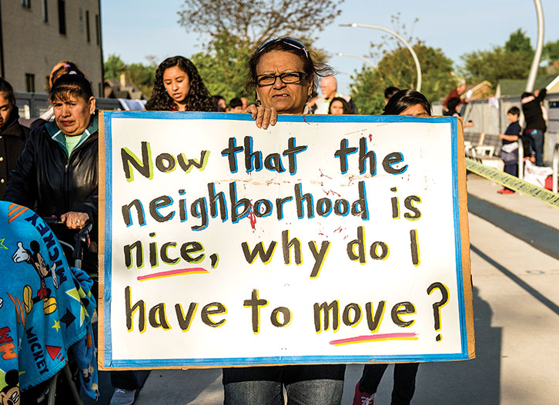
Displacement and Environmental Justice
EPA Definition: "Environmental justice is the fair treatment and meaningful involvement of all people regardless of race, color, national origin, or income, with respect to the development, implementation, and enforcement of environmental laws, regulations, and policies. This goal will be achieved when everyone enjoys:
The same degree of protection from environmental and health hazards, and
Equal access to the decision-making process to have a healthy environment in which to live, learn, and work."
Equal access to decision-making processes about environment and health = residents and businesses being able to comfortably stay in their neighborhoods as brownfields are being revitalized and redeveloped
Notes:
For some more context on this, we'll talk about displacement and environmental justice and how they are connected. Firstly, let's go through the EPA definition of environmental justice (read on slide)
I want to emphasize this last point: equal access to decision-making processes to have a healthy environment. Equitable, fair, inclusive, participatory decision-making in communities would lead to policies and initiatives to protect current residents and businesses from being displaced. There are examples of successful anti-displacement initiatives and communities fighting for their rights that we're happy to share with you. When people are welcomed into spaces where decision are being made and are being called into that process, it results in better outcomes for communities, for public health, for our environment, and the environmental justice movement as well. Environmental justice is about the fair treatment of all people, and preventing displacement is how we can treat the existing residents of our communities with fairness, dignity, and compassion. It's important to note that minimizing displacement and advancing environmental justice go hand-in-hand, and you can't achieve one without the other. (KM)

Slide 13
Discussing Displacement on MAC Grants (FY24)
Identify displacement that will possibly occur
Measurement and Evaluation: develop metrics to evaluate displacement potential (property values, rent, vacancy rates, demographics)
Develop an anti-displacement plan that is tailored for your municipality
Acknowledge the connection between displacement and environmental justice
Prioritize sensitive, underserved populations
Protecting the rights of current residents, small businesses, and underserved groups in your community is advancing environmental justice!
Notes:
Here are some different ways that you can discuss displacement on the MAC grants this year. Firstly, you want to identify any displacement that may possibly occur, especially in underserved populations. After this, you might want to think about property values, rent prices, vacancy rates, demographics within your community – any measurable factors that you can monitor to keep track of displacement. The reason that our understanding of displacement is quite limited is because it's difficult to measure and largely, people have not been measuring it, evaluating it, or keeping track of it. So you really want to consider measurement and evaluation and what that might look like in your community. Perhaps most importantly, you'll want to develop an anti-displacement plan that is tailored to your specific municipality and makes the most sense for your community. On the next slide, we'll have some anti-displacement strategies that you can start thinking about in terms of your own town or city. And lastly, throughout this section of the grant, you want to be mindful of the connection between displacement and environmental justice. So really prioritizing sensitive, underserved populations and emphasizing the importance of protecting the rights of your current residents and small businesses is what's most important here. (KM)

Slide 14
Inclusionary Zoning
Small Business Preservation Programs
Community Benefits Agreements
Tax Abatement
Community Land Trusts
When a non-profit organization purchases housing/land to sell to residents at affordable price
A local policy that requires a certain amount of affordable housing units within a community
Programs that support small businesses through funding, workforce development, etc.
Financial programs and tax reductions aiming to protect residents/businesses from rising costs of living
Contract between community members and private developer
Outlines community needs and desired outcomes
Anti-Displacement Strategies
Notes:
These are some anti-displacement strategies, which you can find more information about on the EPA website or through our TAB resource that I'll share with you shortly. These are strategies that have been identified as effective specifically for minimizing displacement in the context of brownfields redevelopment. We have community benefits agreements, community land trusts, inclusionary zoning, small business preservation programs, and tax abatement.
Starting at the beginning, community benefits agreements are contracts between community members, private developers, and usually the local government as well. CBAs outline the needs of the community, the benefits and outcomes from the redevelopment project that the community wants to see, and goes through how funding will be used in plain language. These agreements are formed and implemented by the partnership between the stakeholders that I just mentioned, but anyone in the community can express interest or start organizing to create one.
Community land trusts or land banks refer to a non-profit purchasing housing or plots of land to sell to their community's residents at an affordable price. These are best for communities that have a non-profit with the financial and organizational capacity to take on a project like this.
Inclusionary zoning is a local policy that requires a certain amount of affordable housing units within a community. Usually, a certain number of units within a housing development will be set aside for people and families under the average income. This is something that needs to be implemented by your local government, specifically a land use or zoning board, or your local housing department.
Small business preservation programs, like the name says, are programs that support small businesses and owners of small businesses in a wide array of different activities. These can be implemented by the local government or economic development department, and they are best for municipalities where there is a strong network of small businesses that have a solid foundation already established within their community.
Lastly, tax abatement programs lower taxes for developers and homebuyers, with a heavy focus on homebuyers who identify as working class or low-income. Tax abatement requires a lot of planning, a lot of communication, and a lot of knowledge on your community – not to say that these other strategies don't require any of these (they certainly do) - but if your community doesn't have a really strong economic development or community development department, it might be challenging to get this implemented. Programs like this need to be frequently revisited and changed as your local economy changes, but if you have the capacity for it, it's very effective and there's examples of tax abatement being used for energy efficiency and climate resiliency – definitely something to consider. (KM)

Slide 15
Do you have experience with any of these strategies? Did any of them seem like a good fit for your own anti-displacement plans?
Notes:
We're curious to know... (question on slide) (KM)

Slide 16
Notes:
Here at TAB, we have developed an anti-displacement that goes into a lot more detail on these anti-displacement, provides some guiding reflection questions to help get you thinking about each strategy, and will eventually some case studies for each. Still working on those, but our hope is that case studies will help you visualize how each strategy might really impact a community. (KM)

Slide 17
Example:
There are significant efforts underway to minimize displacement and protect quality of life for existing residents while also leveraging the benefits of economic growth.
The target area's neighborhood association and municipal government (partnered with identified stakeholders from Section 2b) have been working towards the creation of a Community Benefits Agreement (CBA). The CBA will outline community needs, desired benefits of residents and local businesses, and how funding for this project will be used. Keeping residents and businesses in their neighborhoods is an integral to the CBA and (town/city)'s overall vision. The CBA will be initiated with stakeholders prior to redevelopment and utilize community engagement tactics to ensure underserved groups are supported throughout the redevelopment process.
Identify and name displacement
List specific strategy for minimizing and combatting displacement
Acknowledge importance of protecting current residents / businesses
Notes:
This is an example that I wrote for a pretend town, but I used some language from different grants that I've read and tried to come up with something that might be helpful. I'll read the example out loud.
So, I know that everything on your MAC grants has to be concise and you have a lot of information to fill in. But I would keep in mind how many points this environmental justice section is worth. It's okay to not know what displacement might look like or how it might occur, but preparing, planning, and implementing strategies to measure and minimize displacement is really important. A little formula that you can follow to keep this section succinct and also convey how important EJ is to your community
Name and identify displacement: a lot of grants that I've read through didn't even include the word "displacement", they may have talked about related topics or tried to skirt around it, but you'll do better if you openly discuss displacement, show that you have an understand, and explain what you’re going to minimize it
List a specific strategy or write a little about the anti-displacement plan that you think suits your community
Through your writing, acknowledge the importance of protecting current residents and the importance of EJ
The EPA wants to give grants to communities that are passionate about environmental justice, about meaningful community engagement, about redevelopment projects that support underserved populations, and especially now, about minimizing displacement. (KM)

Slide 18
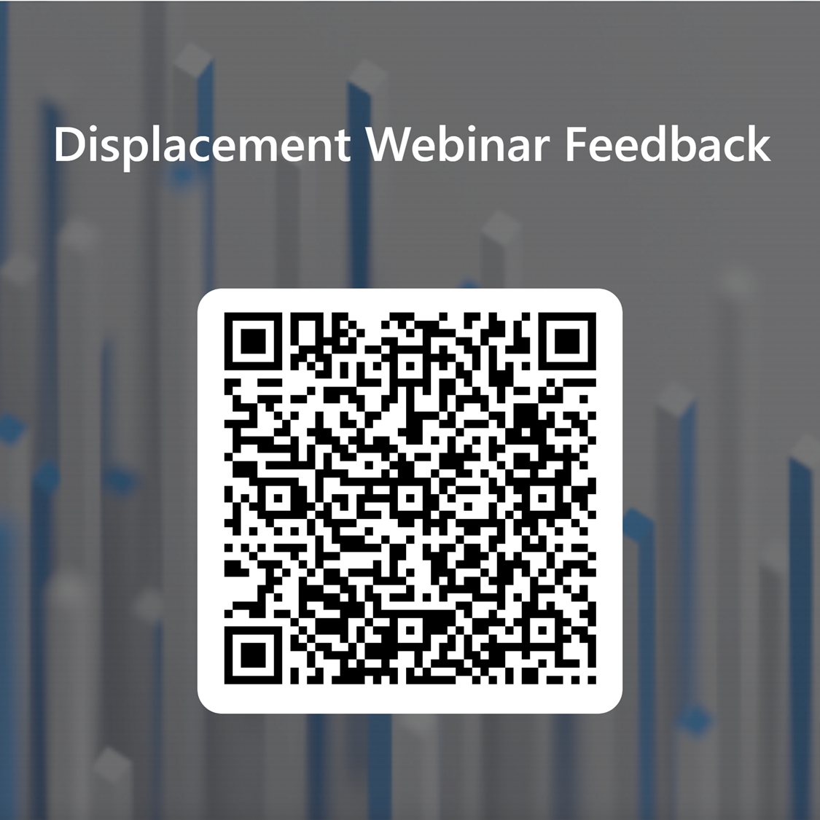

Slide 19
Contacts
Rupal Parekh, PhD
Community Engagement Coordinator
Assistant Professor
UConn School of Social Work
rupal.parekh@uconn.edu
Katie Malgioglio, MSW
Community Liaison
Community Engagement Coordinator
UConn Technical Assistance for Brownfields
katherine.malgioglio@uconn.edu
uconn-tab@uconn.edu
tab.program.uconn.edu

Slide 21
Community Engagement in Practice

Slide 22
Community Engagement in Practice

Slide 23
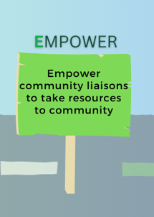
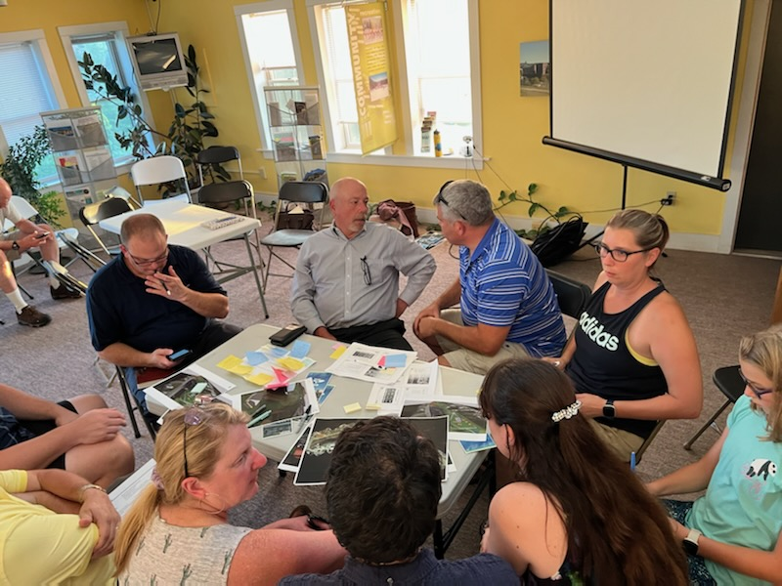
Community Engagement in Practice

Slide 24
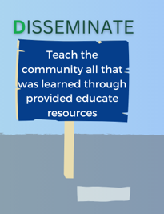
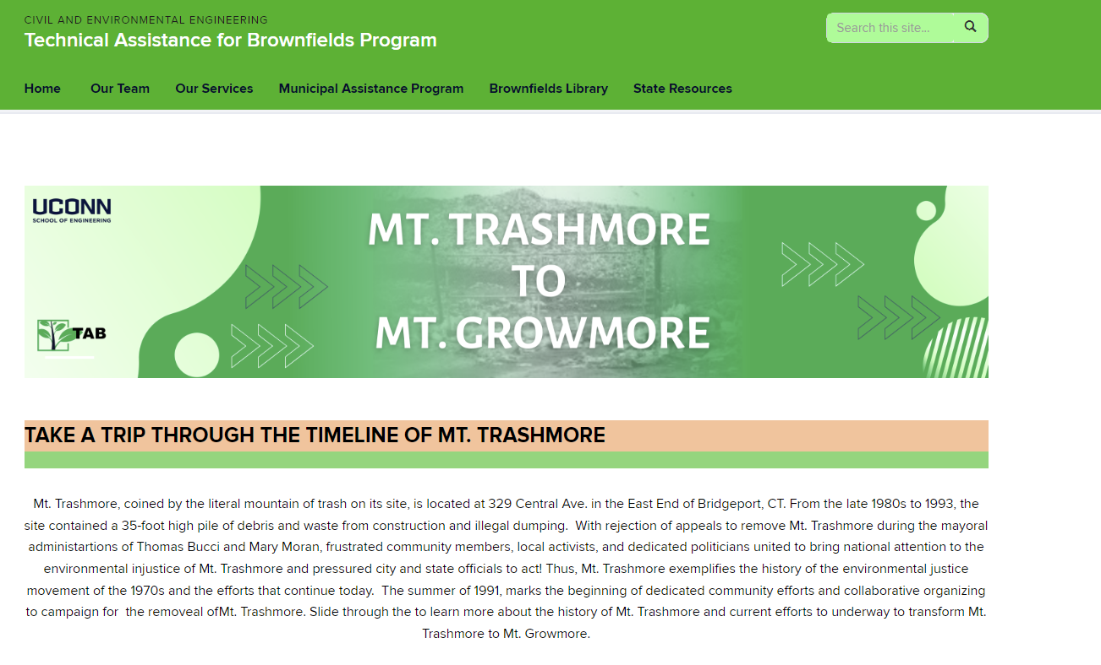
Community Engagement in Practice

Slide 25
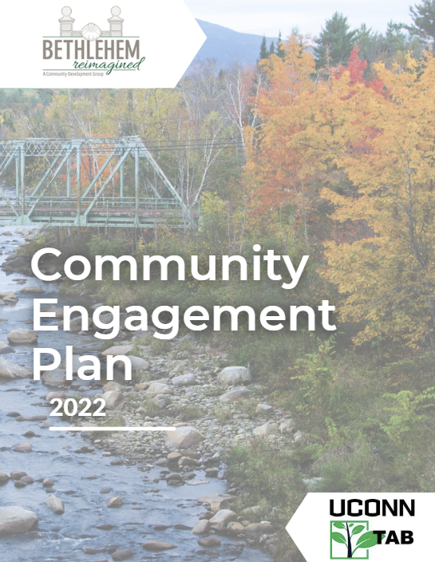
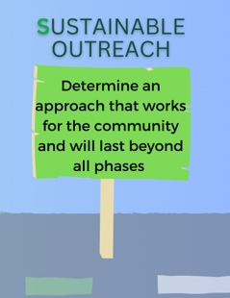
Community Engagement in Practice

