Slide 1
SEEDS Framework: Community Engagement
Technical Assistance for Brownfields EPA Region 1
Katie Malgioglio, LMSW: UConn TAB Community Liaison & Community Engagement Coordinator
University of Connecticut
February 7, 2024
Notes:
Good afternoon, everyone (Rupal introduces herself, then Katie introduces herself)
Welcome to today's webinar on Community Engagement and EPA MAC Grants. Thank you for joining us. Our goal today is to help everyone here feel more comfortable writing about, talking about, and practicing community engagement – specifically in the context of brownfields grants and the brownfields redevelopment process.

Slide 2
Webinar Outline
What is Meaningful Community Engagement?
SEEDS Framework
Examples From Each Phase of Framework
Questions
Notes:
In today's webinar, we'll be doing a brief overview of MAC Grants, discussing meaningful community engagement and how this practice benefits communities, and going over the grant writing guidelines. More specifically, we'll look at Section II of the Narrative (which go over community need and community engagement), considerations for assessment and cleanup grants, and some of our own resources at TAB that we think might be useful for you. We will conclude with an example that showcases a strong Section II of the Narrative, have a few discussion questions throughout the presentation, and we'll leave time at the end for a Q&A.

Slide 3
Community Engagement in Brownfields
Community engagement refers to people, governments, and organizations working collaboratively through the brownfields redevelopment process to:
Establish and uphold a community vision
Support underserved populations
Create sustainable outcomes
Community engagement is especially important in brownfields redevelopment due to history of environmental racism and injustice
Notes:
(Read first bullet point)
Some fundamental ideas in community engagement are mutual decision-making, accessibility, and inclusivity. In practice, this looks like: the celebration of diverse voices and lived experiences, public access to important information and resources, and community members being included and welcomed into spaces where decisions are being made
Meaningful community engagement is also having open conversations, particularly around community concerns and social barriers. Building trust can be a challenge when working with underserved populations, which is why it's important to know your community's history and when possible, enlist the help of community liaisons. Community liaisons can be local citizens or organizations that truly know and care about their community, have connections with their fellow residents, and want to help spread the word about brownfields redevelopment projects and even help relieve the anxiety some community members might have about brownfields redevelopment.
Community liaisons can help in creating a shared community vision. Creating a shared vision amongst diverse residents is an important step to ensuring that there is a seat at the table for everyone and that your redevelopment project will support the needs and goals of your enire community.
Environmental justice communities must be at the forefront of our discussions on keeping residents involved and engaged. EJ communities are disproportionately impacted by environmental hazards, including brownfields, and have been historically left out of decision-making processes. Empowering residents in these communities is crucial to meaningful community engagement.
It's important to acknowledge that community engagement will look different for each community, especially depending on where you are in the brownfields redevelopment process. Despite these differences, the core principals and main ideas of meaningful community engagement remain the same and any community can use them as a foundation to get started.

Slide 4
Meaningful Community Engagement
Building trust and power in communities
Active, empathetic listening
Information sharing & transparency
Meeting people where they are
Plain Language
Authentic connections and partnerships
Notes:
Through our work at UConn TAB, we've been able to identify some key principles of community engagement. These include plain language, information sharing and transparency, active and empathetic listening, building trust and power within communities, meeting people where they are, and authentic connections and partnerships.
Plain language is designed to make sure that writing or speaking can be easily, clearly understood by any audience. In the world of brownfields, there is a lot of convoluted language and acronyms that can be difficult to wrap our heads around, so using plain language is important to any community engagement efforts.
Information-sharing and transparency refers to accessibility and making sure that resources and materials are available to the general public, and it's especially helpful when information is available in plain language as well as different languages spoken throughout the community
Active, empathetic listening is key to opening a dialogue and creating a safe space where residents can make their voices heard
Meeting people where they are and working with them instead of for them or on behalf of them is how we can create authentic connections and partnerships. We can use those authentic connections and partnerships to build trust and power in communities, which lies at the heart of this work.
These principles all work interdependently to create meaningful community engagement, and you can put them into practice using the framework on the next slide

Slide 5
Notes:
UConn TAB recently developed the SEEDS Framework to lay the foundation for meaningfully community engagement.
First, we want to identify the key community stakeholders through a stakeholder analysis. Finding diverse stakeholders that truly represent your community will give you a strong start to community engagement, and you can use TAB's "stakeholder analysis tool" to help you do this. We will show you an example of this later in the presentation.
The next phase of the framework is EDUCATE, where communities can utilize our resources to spread knowledge on brownfields and local redevelopment projects. Our "Brownfields 101" video is 5 minutes long, in plain language, and gives a great description of brownfields and the redevelopment process. The Brownfields 101 can also be tailored to your community.
EMPOWERMENT includes community liaisons and community champions to help reach more people throughout the community and utilize their existing connections and knowledge to share information and resources. Train the trainer methods also can be used to trainer a wider audience.
DISSEMINATE is the next phase of the framework. During this phase, we want to share lessons learned and key takeaways with the wider community, in different neighborhoods and sectors, and make sure that resources and information are accessible and understandable to everyone. UConn TAB's community pages, which are customized for each community we work with and serve as a landing page for all project updates, can be really helpful during this process. We also encourage communities to work with their local libraries and other various community settings such as senior centers, community centers to disseminate resources and information.
And finally, sustainable outreach will help us determine an approach to community engagement that works for the community and will last beyond all phases. Your community engagement work can and should continue past brownfields redevelopment, and at TAB, we want to make sure that each community we work with is equipped to keep practicing meaningful, sustainable community engagement. We help communities do this by working with them to develop a comprehensive long-term Community Engagement plan.

Slide 7
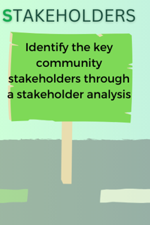
Community Engagement in Practice

Slide 8
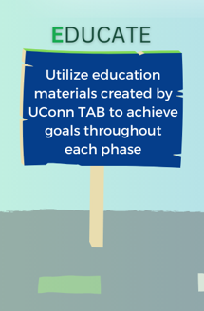
Community Engagement in Practice

Slide 9
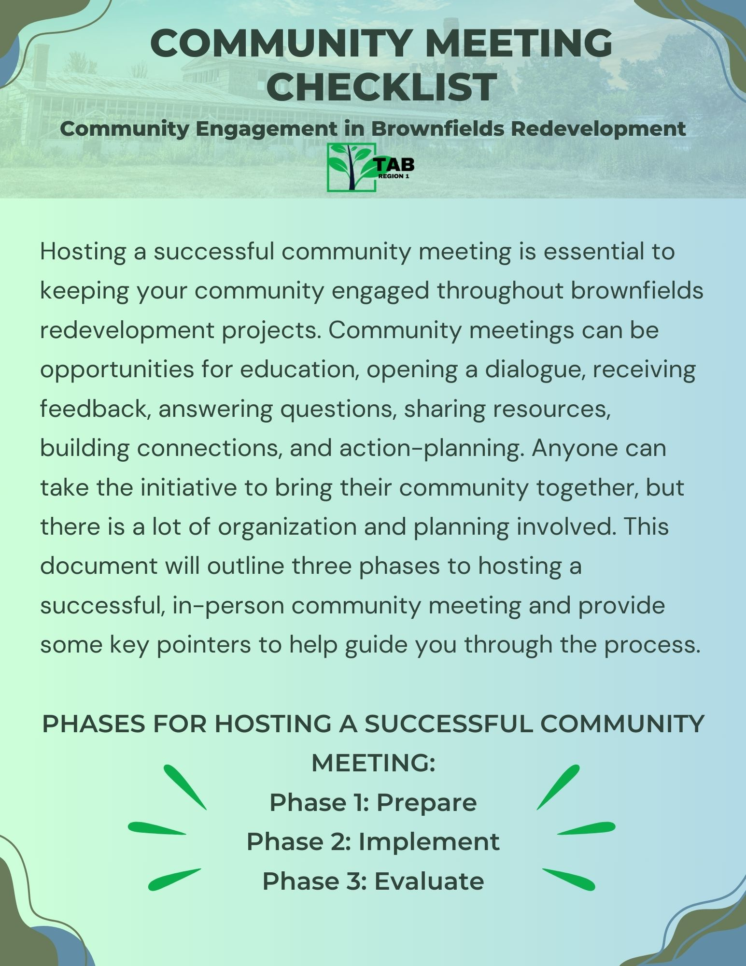
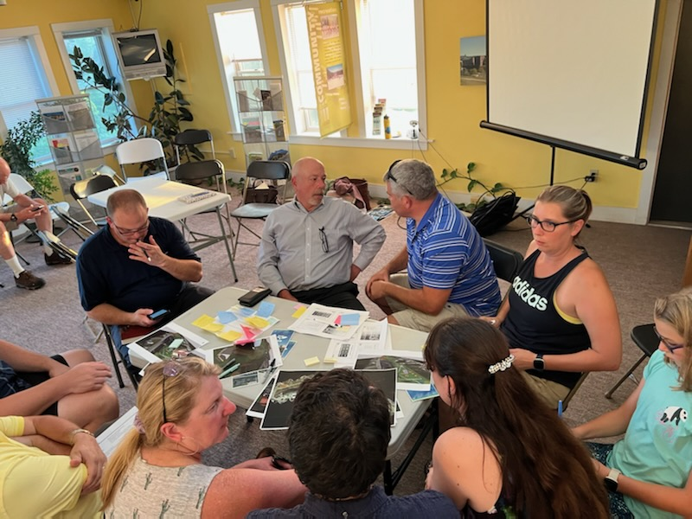
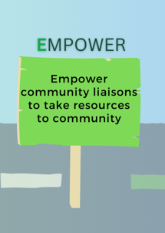
Community Engagement in Practice

Slide 10
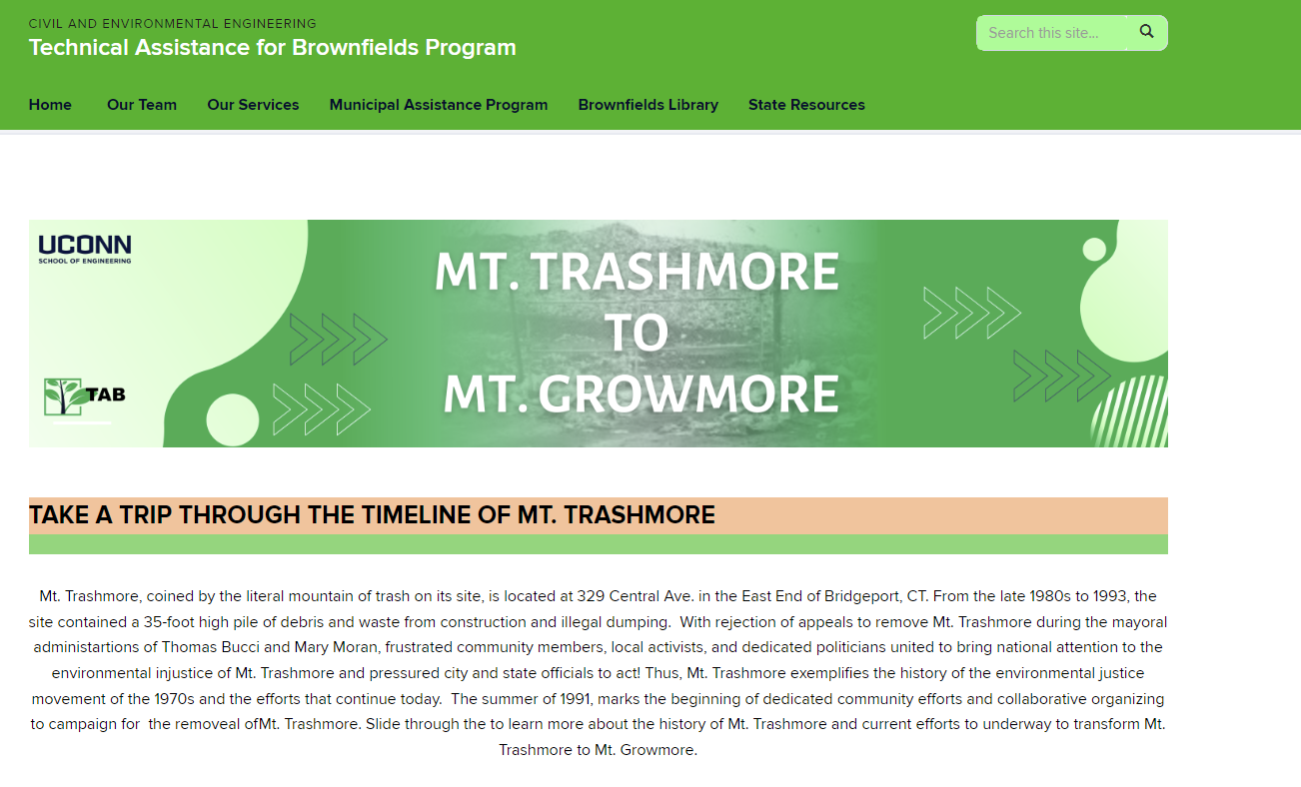
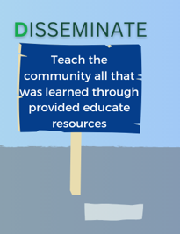
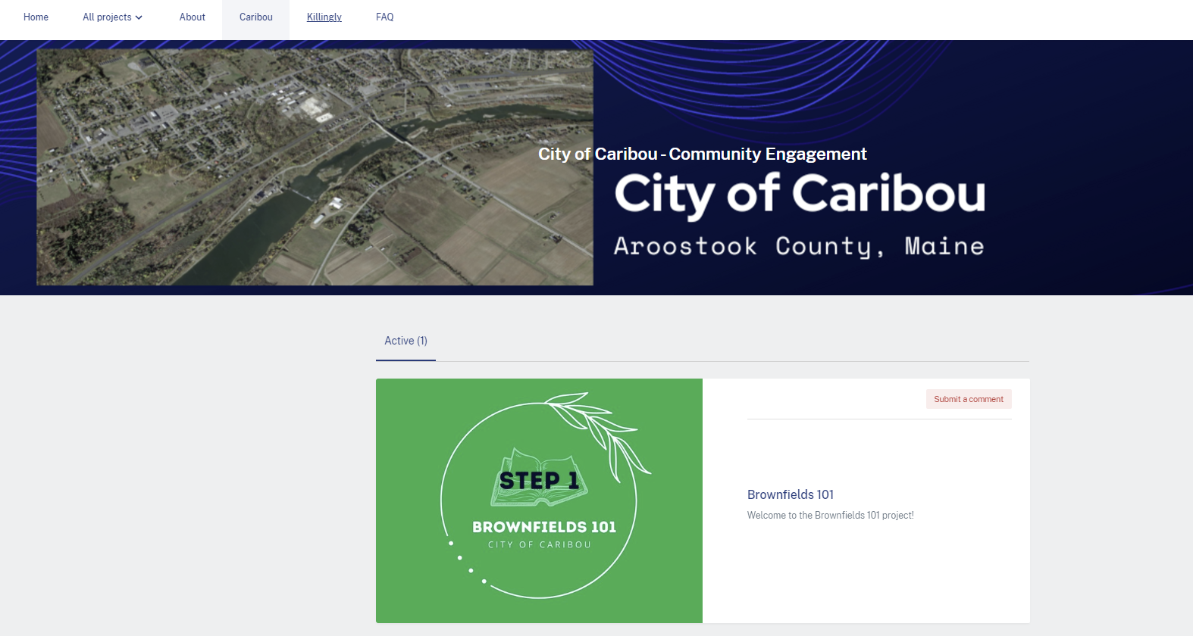
Community Engagement in Practice

Slide 11
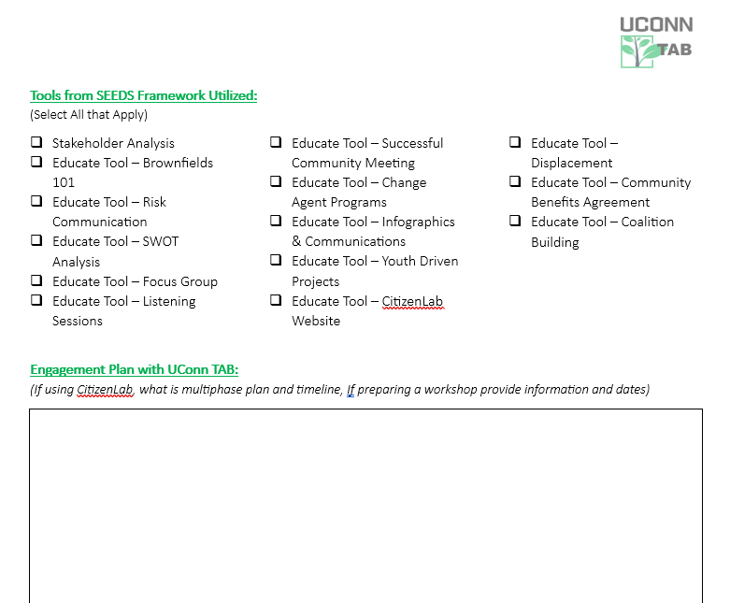
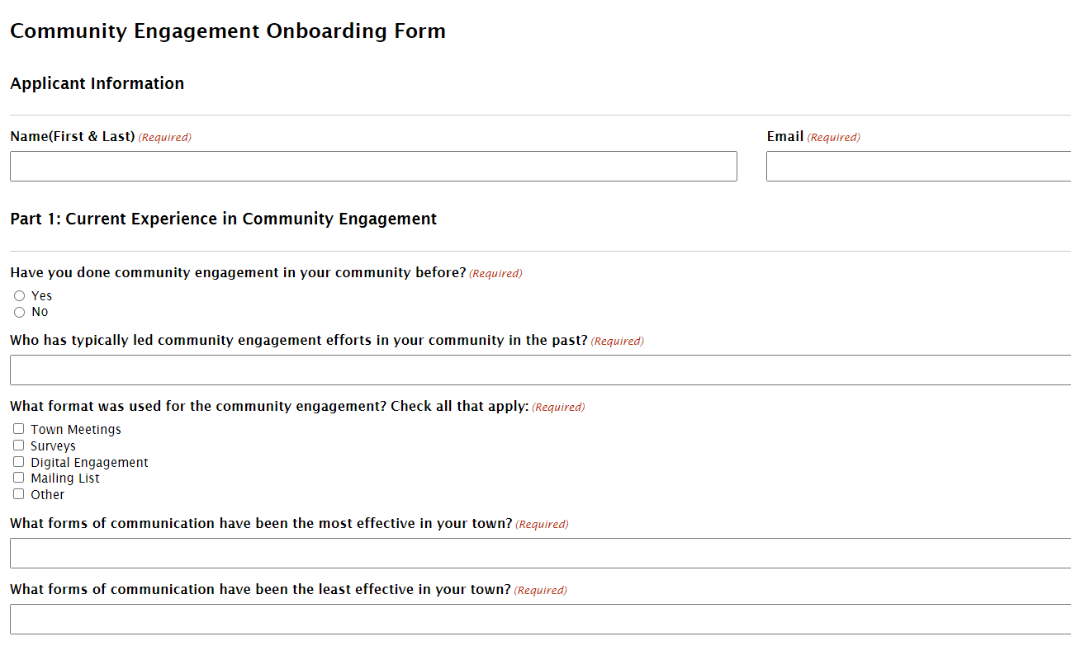
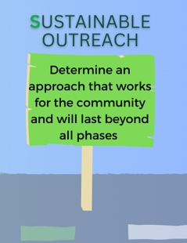
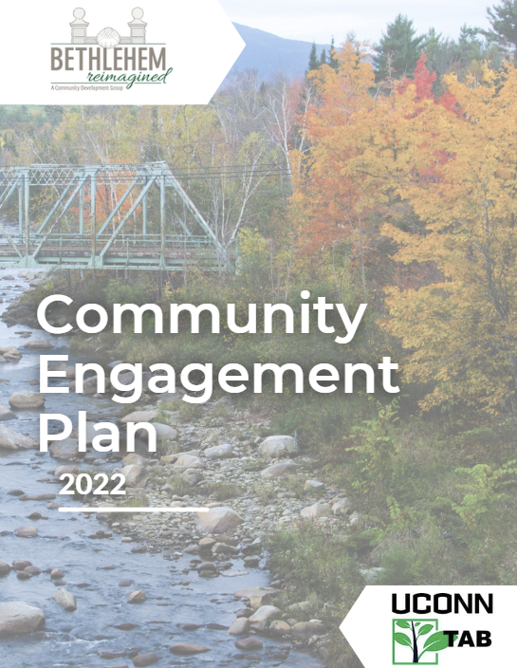
Community Engagement in Practice

Slide 12
In Conclusion...
Community Engagement is a VITAL part of the brownfields redevelopment process
TAB is here to help and our services are FREE
SEEDS Framework – resources ready to go!
Customizable webpages and Community Engagement Plans
Support with public meetings

Slide 13
Questions?
Technical Assistance for Brownfields EPA Region 1
Notes:
Good afternoon, everyone (Rupal introduces herself, then Katie introduces herself)
Welcome to today's webinar on Community Engagement and EPA MAC Grants. Thank you for joining us. Our goal today is to help everyone here feel more comfortable writing about, talking about, and practicing community engagement – specifically in the context of brownfields grants and the brownfields redevelopment process.

Slide 14
Contact Info & Upcoming Webinars!
Katie Malgioglio, LMSW
Community Liaison
Community Engagement Coordinator
UConn TAB
katherine.malgioglio@uconn.edu
uconn-tab@uconn.edu
tab.program.uconn.edu/community-engagement/

