Slide 1
Office of Brownfield Remediation and Development (OBRD)
Department of Economic and Community Development

Slide 2
OBRD Program Overview
Binu Chandy, Director and OBRD Team
Office of Brownfield Remediation & Development
Connecticut Department of Economic & Community Development

Slide 3
CT DECD’s Office of Brownfields Mission
A one stop state resource for brownfield redevelopment in Connecticut
Provide financial and technical assistance
  to brownfield stakeholders
  to help return brownfield sites to productive re-use.
OBRD partners and collaborates with other state agencies including the CT DEEP to further it’s mission.

Slide 4
DECD OBRD Metrics
From FY 2014 to 2025
The CT DECD has allocated substantial state resources to reactivating brownfields:
$280 million of state funding invested
Over 272 projects in
75 municipalities
Cleaning up approximately 3,900 acres of impacted property.
These investments have leveraged significant non-DECD funding as well.
For every $1 contributed by DECD, non-DECD partners have or will invest an impressive $13.13!

Slide 5
OBRD Program – Merits
Predictability of funding and schedule
Multiple program options
Access to programs for public and private stakeholders
Programs available from cradle to grave – brownfield redevelopment cycle
Simple application forms and process
Flexibility on eligible uses
Less restrictive than some federal funding programs
Large funding pool – can take on all magnitudes of brownfield projects
Multiple incentives including offering liability relief to attract developers
Available to all 169 municipalities
Strong collaboration with CT DEEP

Slide 6
Primary Competitive Funding Programs
Limited Assessment and Remediation Grant
Assessment-Only Grant
Targeted Brownfield Development Loans
Brownfield Area-Wide Revitalization Planning Grant

Slide 7
Funding Rounds Schedule
2 competitive funding rounds per year
Announcements made Jan/Feb and June/July
Each round is approx. 6-month cycle
  Submission: Month 4
  Announcement: Month 6
Governor’s proposed state biennium budget includes $70M
Typically - $25M announced each round

Slide 8
Summary of Funding Programs
PROGRAM | MAX per application | MIN per application | Notes
Grant – Remediation/Limited Assessment | $4 million | $200,000 | Current legislation pending that would increase the limit to $6M
Loan – Remediation/Limited Assessment | $4 million | $500,000 | Min. is $500K
Grant – Assessment-only (Land Banks/COGs) | $500,000 | $100,000 | Can apply for multiple projects/sites. Maximum per project - $200K
Grant – Assessment-only (Others) | $200,000 | $100,000
Grant – BAR Planning | $200,000 | none | Min 10% match requirement

Slide 9
Remediation/Limited Assessment
Grant & Loan Programs
Primary mission - bringing brownfields to economic productivity and community value
Past projects – adaptive reuse or new construction
  Housing/Mixed-uses/TOD
  Industrial/Commercial/Retail/Business
  Recreational/Community/Parks
  Health-related end uses/Research facilities
  Green Energy Focus
Competitive process
Multi-dimensional scoring

Slide 10
Eligible Applicants for Grant Program
Per C.G.S. Section 32-760 (6), (12), (22)
Municipalities
Economic Development Agencies / Corporations
Councils of Governments
Connecticut Brownfield Land Banks
Entities responsible for the contamination are ineligible.
All applicants must provide proof of access to the site, site control or path to site control.

Slide 11
Eligible Applicants for Loan Program
Potential brownfield purchasers
Current brownfield owners
All grant-eligible entities
Persons or entities responsible for the contamination are ineligible
All applicants must provide proof of access to the site, site control or path to site control.

Slide 12
Public-Private Partnership
DECD encourages private entities to partner with grant-eligible entities
Helps with arriving at cost-effective remediation solutions
The Assistance Agreement (DECD Contract) can be structured to enable a pass-through of the grant from eligible entities to private partner entities
Private partners will have to accept DECD’s collateral terms and property restrictions including
  mortgage liens,
  unlimited corporate/personal guaranty,
  negative pledge and/or use restriction (as applicable, on a case-by-case basis).
Please view webinar recording on public private partnerships on different options

Slide 13
Threshold Requirements
Site is a brownfield as per C.G. S. Sec. 32-760.
Applicant and potential development partner(s) have no direct or related liability for the conditions of the brownfield.
Applicant or potential development partner has access or will have access to the property, site control or path to site control.
Potential development partner is registered to do business in the State of CT and is in good standing – no pending lawsuits, liens filed or tax arrears.
If the redevelopment project has a housing component, proof that it will comply with DECD’s Affordable Housing policy.

Slide 14
Brownfield Definition
As per C.G.S. Section 32-760
Abandoned, vacant or underutilized
No redevelopment, reuse, or expansion due to presence or potential presence of pollutants in buildings, soil or groundwater
Requires investigation or remediation to enable redevelopment, reuse, or expansion

Slide 15
Application Review & Award Criteria
Shovel Readiness
  remediation plan
  assembly of financing/presence of developer
  redevelopment plan completeness
Economic and Community Development Impact
  Project in Opportunity Zone/Distressed municipality/Env. Justice (EJ) goals
  Property value/tax contribution/Jobs
  Supports industrial sectors in CT economic development strategy
  Supports renewable energy sector
  Green building design/resiliency features
  Other DECD initiatives – TOD, adaptive reuse, affordable housing
  Developer interest and non-DECD support
Financing
  Applicant/Developer partner contribution/share
  Private leverage of funds
  (For loans - loan to value ratio; developer equity)
Applicant Experience
  Applicant experience with completing similar projects on time and within budget

Slide 16
Eligible Uses of Funds
Limited investigation, assessment, planning, environmental consultancy
Soil and groundwater remediation
Abatement; hazardous materials or waste disposal; demolition activities
Groundwater monitoring; institutional/engineered controls
Attorneys’ fees (not DECD-contract related tasks)

Slide 17
Assessment-only Program
Value-driven
Sowing the seeds for brownfield redevelopment
Helps stakeholders understand issues
Potential/Cost-benefit for redevelopment
Potential end uses (including highest and best end use)
Attracts developers
Public information
Note: Can collaborate with private entities but grant-eligible entity will have to implement the project

Slide 18
Other Programs
DECD/State has other programs where brownfield clean up are an eligible expenditure
CIF 2030
Urban Action program
Other state programs that can be layered based on end use:
For affordable housing projects – you may be seeking DOH or CHFA financing
For adaptive reuse of a historic resource – you could be exploring historic tax credits
CT Green Bank

Slide 19
DECD’s Liability Relief Programs

Slide 20
Liability Relief Programs
We offer 2 programs
  Abandoned Brownfield Cleanup (ABC)
  Brownfield Remediation and Revitalization (BRRP)
Manage program in collaboration with DEEP
Removes certain liability aspects associated with redevelopment of brownfields, incentivizing brownfield redevelopment.
Intended to attract developers to acquire and invest in redevelopment of brownfield sites that typically have limited market interest.
The programs are also available to Municipalities, CT Brownfields Land Banks, and Economic Development Agencies who are exploring to purchase a brownfield property and creating a path for redevelopment of brownfield sites.

Slide 21
Benefits
The main benefits include:
No obligation to investigate/remediate off-site pollution
Investigation and remediation limited to site boundaries
Liability relief from State and third parties
Exemption from the Property Transfer Act Program

Slide 22
Application Process
Pre-application meeting (not mandatory)
Submit application form to DECD.LiabilityReliefProgram@ct.gov
Prior to purchase of property
DEEP reviews and recommends
DECD reviews and makes decision on risk and economic/community benefits criteria
Decision sent to applicant
Requirements for each program

Slide 23
New Resource Pages on Website!
Updated application forms
Brand new FAQs
Helpful information for first-time applicants
Guidance to chose program that fits a particular site, applicant or project
Visit www.ctbrownfields.com – navigate to Liability Relief Programs

Slide 24



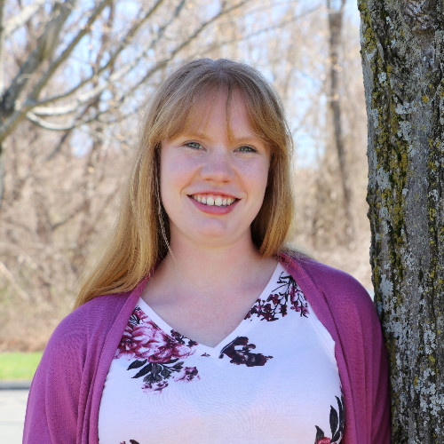


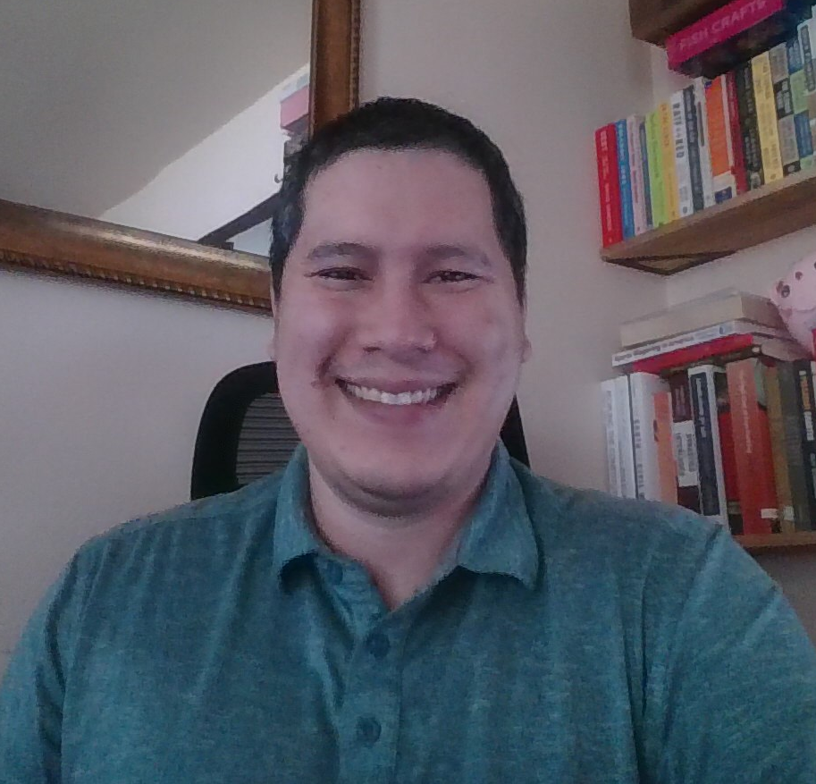

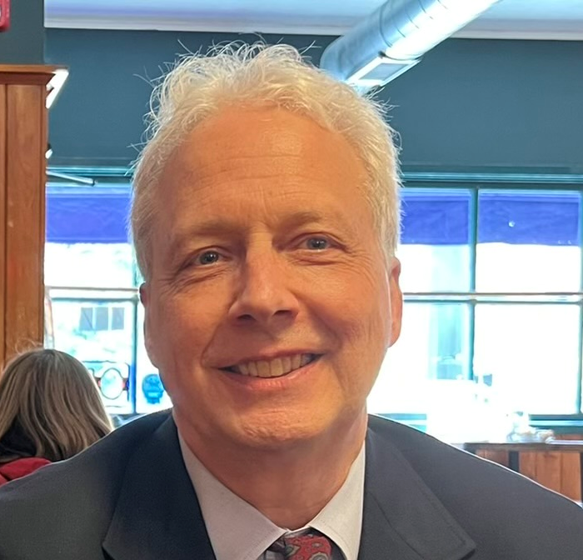


DECD BROWNFIELDS TEAM
Mike Wieliczka
Administrative Support
Binu Chandy
Binu.Chandy@ct.gov
860-500-2454
OBRD Director
Almariet Roberts
Almariet.Roberts@ct.gov
Contracts Team Lead
Jennifer Schneider
Jennifer.Schneider@ct.gov
860-500-2367
Technical Team Lead
Preston Piper
Preston.Piper@ct.gov
Project Manager - Contracts
Greg Ambros
Gregory.Ambros@ct.gov
860-500-2363
Project Manager - Contracts
Shawntay Nelson
Shawntay.Nelson@ct.gov
860-500-2493
Project Manager - Contracts
Mark Burno, LEP
Mark.Burno@ct.gov
860-500-2442
Project Manager - Technical
Shay Sabir
Chaimae.Sabir@ct.gov
860-500-2448
Project Manager - Technical
James Parsley
James.Parsley@ct.gov
860-500- 2335
Project Manager - Technical

Slide 25
For additional questions or to arrange for a meeting:
Please send email to brownfields@ct.gov (preferred) or
Contact the dedicated OBRD hotline number at 1.860.500.2395
Visit the OBRD Website:
www.ctbrownfields.gov

Slide 26
Q&A

Slide 27
Thank you!

